Slide 1
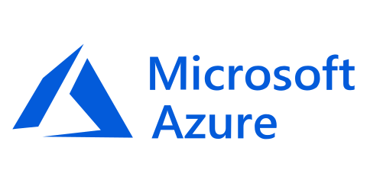
Provision, secure, connect, and run any infrastructure for any application
bit.do/terraformworkshop
Notes:
Hi, my name is ________. I am the __________ for HashiCorp and here to talk about Terraform, one of the product in the HashiCorp Suite.
The mission of the HashiCorp suite is to provide products singularly focused on a goal: a product to provision, one to secure, one to run, and one to connect any infrastructure for any application.
Today we will talk about the provisioning piece with Terraform.

Slide 2




Tom Straub – Cardinal Solutions
I
Code

Slide 3



Cardinal Solutions
https://www.cardinalsolutions.com
Notes:
to provide better technology solutions that advance your business.
Who is Cardinal?
Cardinal Solutions is a national solution provider. We lead with our experience and expertise in digital solutions across cloud, data and analytics, mobile, and web, while collaborating with clients through an agile process that allows organizations to be more creative and flexible in responding to user and stakeholder feedback. Established over 20 years ago, we continually evolve our solution offerings to adapt to the changes in technology and the needs of our customers. With 500 employees in seven locations in the Midwest and Southeast, we connect with clients across the country to help advance their business, while also providing strategic guidance, training, and mentoring.
Cardinal has a rich history of digital transformation with Azure. Our expertise in native cloud applications, mobile/digital, internet of things, analytics, and modern data center (including open source solutions) enables us to develop complex software solutions in the cloud. Our approach is to educate the customer on the possible, via real-life case studies, with the focus on innovation. Our portfolio includes over 50 successful deployments that range across a variety of industries and workloads. We help you craft a strategy that gets you started on the path to innovation in the cloud.

Slide 4
What’s in a Workshop
Slides -> Challenges -> Slides -> Challenges
Clone the workshop repo -> bit.do/terraformworkshop
Import links are at the bottom of the slides
https://github.com/CardinalNow/TerraformWorkshop
Notes:
Recipe for success
This presentation is in the /docs folder
Mix of presentation and hands on labs
Links for more information

Slide 5
Workshop Expectations
Purpose
Why are we here?
Gives
What do you need to do?
Gets
What will get you get?
Notes:
Talk through goals of the workshop
Learn how and why Terraform on Azure
We need participation in the challenges, ask questions, etc…
They will get first hand experience with technical experts and a firm understanding of how to get started

Slide 6
Pre-Session Survey
https://goo.gl/forms/R1va12J0ZEUplv2D3
Notes:
Who here is in Azure now?
Using Terraform now?

Slide 7
Agenda
Overview
Terraform Workflow
Challenge: Connecting to Azure
State, Variables, & Outputs
Challenge: ACI
Interpolations & Modules
Challenge: Modules
Terraform Enterprise
Challenge: Workspaces
Collaboration & Private Registry
Challenge: Private Registry
Governance
Challenge: Sentinel Integration
Closeout & Questions
Lunch
Notes:
Intro and Overview of IaC, Terraform, and Azure – give us a solid base to start discussing higher level topics
Lunch – Solution Discussion, Free form, whiteboard

Slide 8
Hashicorp

Slide 9
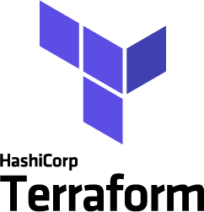


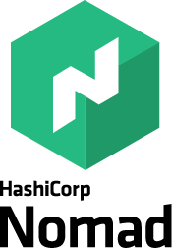

Company overview
Founded
2012 by Mitchell Hashimoto and Armon Dadgar
Mission
We enable organizations to Provision, Secure, Connect, and Run any infrastructure for any application
Key Products
Notes:
Founded: As Ops Practitioners moving to the cloud, gaps in provision, secure, run.
Mission: Any, could be cloud native, hybrid, etc…
How: Open source projects, Enterprise (collaboration and governance)
Without tying themselves to a particular platform or technology

Slide 10
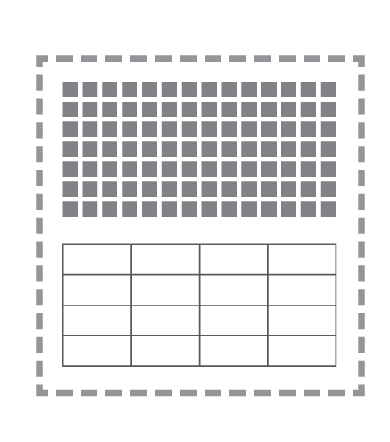
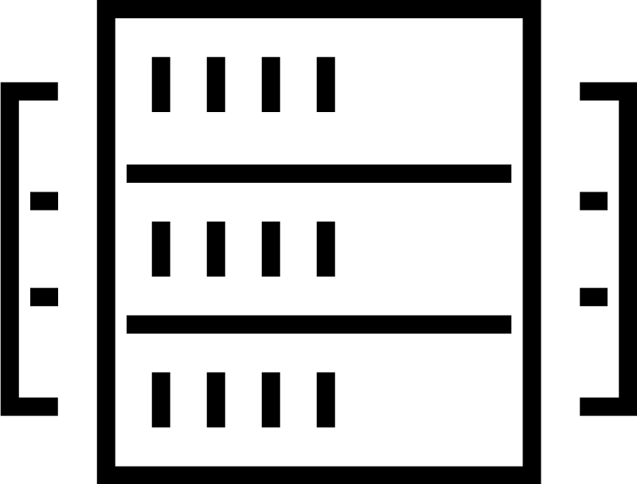
The shift to hybrid infrastructure
TRADITIONAL DATACENTER
Notes:
Journey to the cloud
Traditional Datacenter:
Infrastructure
Applications
Security around perimeter
Straightforward approach.
Scaling up by adding more compute/memory.

Slide 11
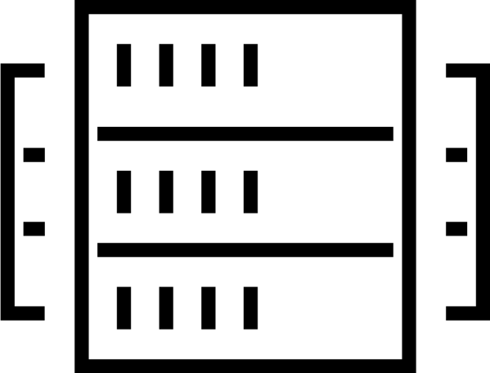

The shift to hybrid infrastructure
TRADITIONAL DATACENTER
EARLY CLOUD
Private cloud
Azure
Notes:
Move to single cloud
IaaS
PaaS offerings
Replication

Slide 12
The shift to hybrid infrastructure
TRADITIONAL DATACENTER
EARLY CLOUD
MULTI-CLOUD
+
Private cloud
AWS
AWS
GCP
…
Notes:
Multi Cloud
COMPLEXITY!
More distribution

Slide 13
The 3 essential elements of infrastructure
DEVELOPMENT
Run applications
SECURITY
Secure infrastructure & applications
OPERATIONS
Provision infrastructure
Notes:
Still have these 3 elements, cloud or on-prem
Each has stakeholders
Operations
Security
Developers

Slide 14
The 4 essential elements of distributed infrastructure
CONNECT
Infrastructure & applications
DEVELOPMENT
Run applications
SECURITY
Secure infrastructure & applications
OPERATIONS
Provision infrastructure
Notes:
Cloud adds a 4th element
Cloud = infinity scale, create/destroy
No more Manual
Dynamic connections

Slide 15
Addressing the challenges of cloud adoption
Notes:
4 Hashicorp tools to address

Slide 16
Cloud challenges for Operations teams
THE PRACTITIONER
DEVELOPMENT
Run applications
SECURITY
Secure infrastructure & applications
OPERATIONS
Scale
Heterogeneity
Dependency management
Provision infrastructure
Notes:
Operations Team Concerns
Secure infrastructure
Scale
Multiple Components and Layers
Dependencies
Ultimately that application must be deployed to the secure infrastructure. This is almost certainly a multi-component app spanning a data layer and a runtime layer, meaning that it almost certainly has heterogenous elements spanning VMs to Containers and probably physical components as well (e.g. a database NOT inside a VM for performance reasons).
And finally the application must be registered with a common service registry so that it can be monitored by the ops team.
That is really the end-to-end software supply chain: the principles have not changed for a long time, but just as the evolution from producing combustion engines to electric engines caused factories to be retooled to accommodate the addition of some new components, the software supply chain requires new tooling to support the realities of modern application infrastructure. It is hybrid, distributed and dynamic in a way that the existing toolchains really aren't designed.

Slide 17
Provision any infrastructure for any application
THE PRACTITIONER
DEVELOPMENT
Run applications
SECURITY
Secure infrastructure & applications
OPERATIONS
Scale
Heterogeneity
Dependency management
Provision infrastructure
Notes:
Terraform
Single language
One cloud
Multi cloud
F5
Public DNS
Anything API addressable
Terraform understands
What does it look like now?
What does it need to look like?
What changes are needed?

Slide 18
Cloud challenges for Security teams
THE PRACTITIONER
DEVELOPMENT
Run applications
SECURITY
Managing distributed secrets
Encrypt data at-rest and in-flight
Privilege access management
Secure infrastructure & applications
OPERATIONS
Provision infrastructure
Notes:
Security Team Concerns:
Data Center -> Firewalls -> Infrastructure
Castle & Moat approach.
Managing dist. Secrets
Encryption
Private Access

Slide 19
Secure any application and any infrastructure
THE PRACTITIONER
DEVELOPMENT
Run applications
SECURITY
Managing distributed secrets
Encrypt data at-rest and in-flight
Privilege access management
Secure infrastructure & applications
OPERATIONS
Provision infrastructure
Notes:
Vault
Cloud – without confidence that the underlying infrastructure is secure

Slide 20
Challenges for Developers / Operators
THE PRACTITIONER
DEVELOPMENT
Decoupling application from infrastructure
Bin packing, machine efficiency
Run applications
SECURITY
Secure infrastructure & applications
OPERATIONS
Provision infrastructure
Notes:
Developers or Operators
Don’t want to care about:
Underlying infrastructure
Firewall rules
Rotating passwords
Decouple the infrastructure
Better binary packaging
Machine Density

Slide 21
Run any application on any infrastructure
THE PRACTITIONER
DEVELOPMENT
Decoupling application from infrastructure
Bin packing, machine efficiency
Run applications
SECURITY
Secure infrastructure & applications
OPERATIONS
Provision infrastructure
Notes:
Nomad
Job file to represent applications
Number of instances to run
Dependencies between them
Nomad figures it out

Slide 22
The connectivity issue in distributed infrastructure
THE PRACTITIONER
DEVELOPMENT
Run applications
SECURITY
Secure infrastructure & applications
OPERATIONS
Provision infrastructure

Slide 23
Connect any application and any infrastructure
THE PRACTITIONER
Service discovery in a dynamic environment
DEVELOPMENT
Run applications
SECURITY
Secure infrastructure & applications
OPERATIONS
Knowledge of real-time configuration
Provision infrastructure
Notes:
Connectivity
Service Discovery in a Dynamic Environment
As nodes come online, Consul is used
Connect dynamically and automatically
Real time configuration (KV)

Slide 24
The HashiCorp open source suite
THE PRACTITIONER
DEVELOPMENT
Run applications
SECURITY
Secure infrastructure & applications
OPERATIONS
Provision infrastructure
Notes:
Hashicorp Suite
Together they build the idea Mitchell/Armond had how infrastructure should be built.
Unix methodology - do one thing, and do it well
Independent use.

Slide 25
Enterprise products build on open source to address organizational complexity
Governance & Policy
Operations
Organizational Complexity
Collaboration
Collaboration
Open Source
Open Source
Open Source
Individuals use
OSS
Teams use
Pro
Organizations use
Premium
Notes:
Open Source – always be there, no artificial limitations
Enterprise
Collaboration (RBAC)
Governance (tagging)
More on this later!

Slide 26
Challenges for organizations as they scale
THE PRACTITIONER
TEAMS
DEVELOPMENT
Run applications
Collaboration
Operations
Governance & policy
SECURITY
Secure infrastructure & applications
OPERATIONS
Provision infrastructure
Notes:
Helping individual practitioners succeed

Slide 27
Challenges for organizations as they scale
THE PRACTITIONER
TEAMS
ENTERPRISE
DEVELOPMENT
DEVELOPMENT
Run applications
Run applications
ENTERPRISE
Collaboration
Operations
Governance & policy
SECURITY
SECURITY
Secure infrastructure & applications
Secure infrastructure & applications
ENTERPRISE
OPERATIONS
OPERATIONS
Provision infrastructure
ENTERPRISE
Notes:
Helping Teams
Building on OSS

Slide 28
Terraform Overview

Slide 29
Terraform provisioning workflow
PROVISIONing WORKFLOW
Plan
Core
Provider
Apply
Notes:
Safely Manage Infrastructure
Core and Provider(s) (extensible)
Plan – verification phase
Differences
Dependencies
Apply – execution phase
Makes changes
One workflow, two steps, any infrastructure.

Slide 30

Terraform provisioning workflow
INFRASTRUCTURE AS CODE
PROVISIONing WORKFLOW
Module
Registry
DEVELOPER
Plan
OPERATOR
Provider
VCS
Core
Apply
Notes:
Input - Terraform Configuration
Holistic config or module (reuse)
Public module registry, free to use/submit

Slide 31
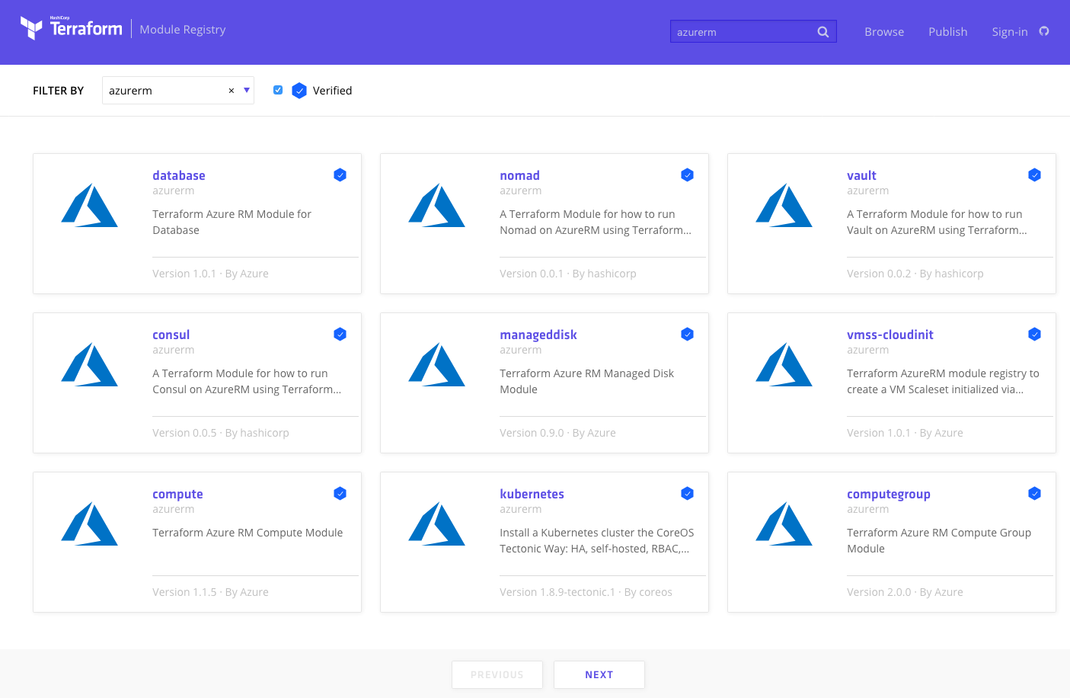
Public Module Registry
https://registry.terraform.io
Notes:
Publish modules
Reusable blocks of code
Terraform Enterprise – offers Private Module Registry

Slide 32
Provision any infrastructure for any application
Extensible provider model
AWS
GCP
Core
Azure
Alibaba
API Integration
Notes:
Extensible Providers
Over 70

Slide 33
Provision any infrastructure for any application
Extensible provider model
AWS
GCP
OPERATIONS
Core
Azure
Provision infrastructure
Alibaba
API Integration
Notes:
Cloud providers: AWS, Azure, GCP, Alibaba, Oracle, IBM, and more

Slide 34
Provision any infrastructure for any application
Extensible provider model
Fastly
GitHub
…
Kubernetes
Heroku
…
DNSimple
Akamai
…
Datadog
F5
…
AWS
GCP
OPERATIONS
Core
Azure
Provision infrastructure
Alibaba
API Integration
Notes:
Other ISVs providers: DNSimple, Datadog, Consul, GitHub, Fastly, and more

Slide 35
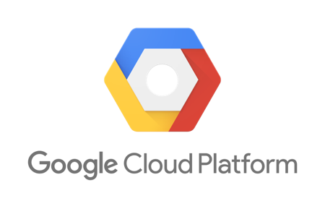
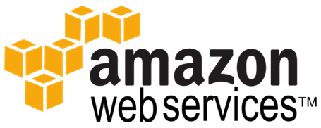


Terraform Ecosystem
Partnerships with 25+ technology providers, community support for many more
Version-control Systems
Infrastructure providers
Core
Provider
List of all 70+ providers www.terraform.io/docs/providers/
Notes:
Partnerships
VCS support

Slide 36
Provision any infrastructure for any application
Infrastructure as Code
OPERATOR
Core
Azure
Terraform Configuration
Notes:
Today we will look at Azure

Slide 37
Provision any infrastructure for any application
OPERATOR
Core
Azure
Kubernetes
Datadog
Notes:
- Consistent workflow for every provider
- Codify resource in a Terraform configuration
- Producer & consumer model
Operators produce infrastructure configurations
Developers consume infrastructure configurations

Slide 38
Provision any infrastructure for any application
Infrastructure as Code
DEVELOPERS
OPERATOR
Core
Azure
Kubernetes
Terraform Configuration
Datadog
Notes:
- Consistent workflow for every provider
- Codify resource in a Terraform configuration
- Producer & consumer model
Operators produce infrastructure configurations
Developers consume infrastructure configurations

Slide 39
Azure Resource Manager

Slide 40
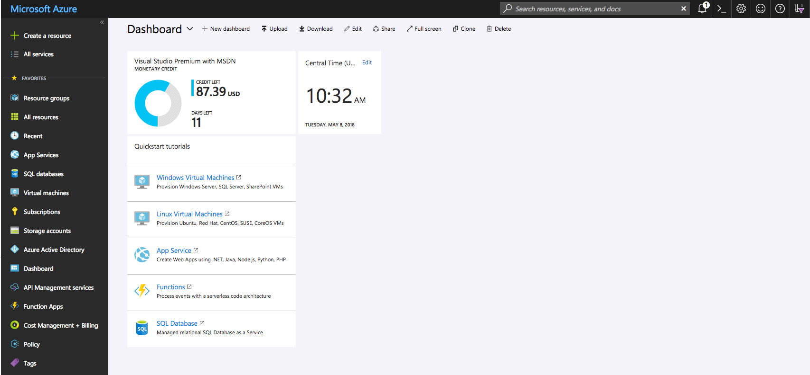
Azure Portal
https://portal.azure.com
https://portal.azure.com
Notes:
We will be using this throughout the day

Slide 41
High Level View
Notes:
Every Tenant can have multiple subscriptions (but a sub can only be in a single tenant)
Each Subscription can have multiple resource groups (but a RG can only be in a single sub)
Each resource can have multiple resources (but a resource can only be in a single RG)
Mention Location/Regions

Slide 42
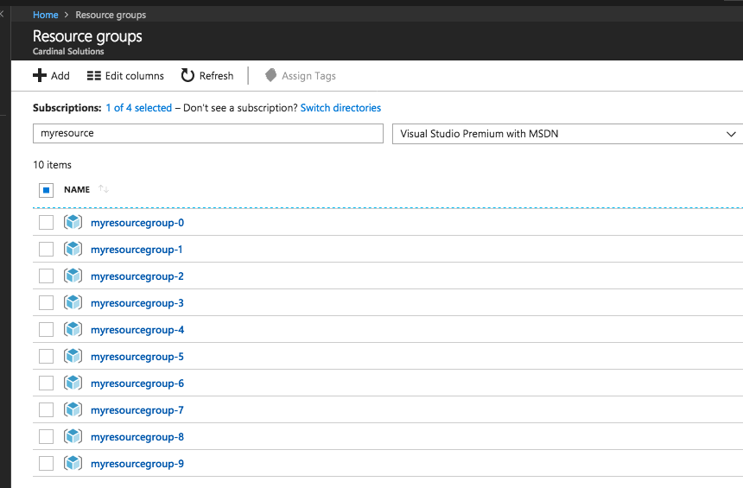
Azure Resource Manager
Resource Group
A container that holds
related resources.
https://portal.azure.com
Notes:
resource group
A container that holds related resources for an Azure solution. The resource group can include all the resources for the solution, or only those resources that you want to manage as a group.
You can deploy, update, or delete all the resources for your solution in a single, coordinated operation.
resource provider
A service that supplies the resources you can deploy and manage through Resource Manager.
Each resource provider offers operations for working with the resources that are deployed.
Some common resource providers are Microsoft.Compute, which supplies the virtual machine resource, Microsoft.Storage, which supplies the storage account resource, and Microsoft.Web, which supplies resources related to web apps. See Resource providers.

Slide 43
Azure Resource Manager
Resource
A manageable item that is available through Azure.
Some common resources are a virtual machine, storage account, web app, database, and virtual network, but there are many more!
Notes:
resource group
A container that holds related resources for an Azure solution. The resource group can include all the resources for the solution, or only those resources that you want to manage as a group.
You can deploy, update, or delete all the resources for your solution in a single, coordinated operation.
resource provider
A service that supplies the resources you can deploy and manage through Resource Manager.
Each resource provider offers operations for working with the resources that are deployed.
Some common resource providers are Microsoft.Compute, which supplies the virtual machine resource, Microsoft.Storage, which supplies the storage account resource, and Microsoft.Web, which supplies resources related to web apps. See Resource providers.

Slide 44
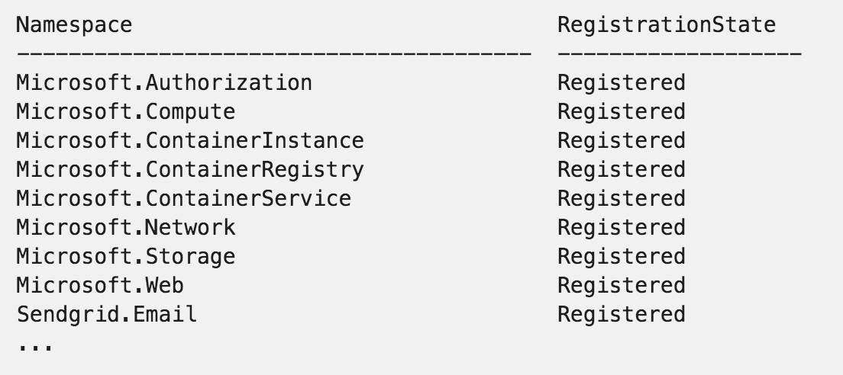
Azure Resource Manager
Resource Provider
A service that supplies the resources you can deploy and manage through Resource Manager.
Notes:
resource group
A container that holds related resources for an Azure solution. The resource group can include all the resources for the solution, or only those resources that you want to manage as a group.
You can deploy, update, or delete all the resources for your solution in a single, coordinated operation.
resource provider
A service that supplies the resources you can deploy and manage through Resource Manager.
Each resource provider offers operations for working with the resources that are deployed.
Some common resource providers are Microsoft.Compute, which supplies the virtual machine resource, Microsoft.Storage, which supplies the storage account resource, and Microsoft.Web, which supplies resources related to web apps. See Resource providers.

Slide 45
Azure Resource Manager
Resource Group
Virtual Network
Subnet
Network Interface
Virtual Machine
OS Disk (from Image)
Resource Group
Virtual Network
Subnet
Network Security Group
Network Interface
Virtual Machine
OS Disk (from Image)
Data Disk(s)
Extensions
Notes:
Add icons to this slide to drive the point
RG with a Vnet/Subnet, few NICs, few VMS Could show a Load Balance, NSG, etc…

Slide 46
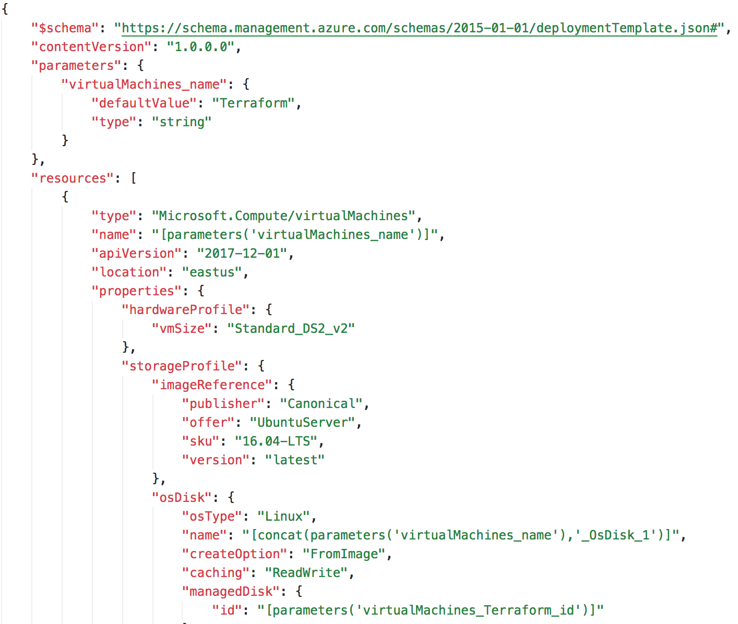
Azure Resource Manager Templates
ARM Templates
JSON file that defines one or
more resources to deploy to a
resource group.
Notes:
When you create anything in the Portal, it is creating an ARM Template and submitting that to a deployment.
Azure Deployment Model

Slide 47
ARM Templates Drawbacks
Cannot verify changes to an environment before executing
Failures can be difficult to trace
Deployments cannot cross resource groups (or subscriptions)
Custom tooling to create a full deployment
Notes:
There are other and overlapping tools out there.
Most tools combine plan and execution
One tool that can deploy to multiple platforms
Can represent infra and CDN or DNS services, etc…

Slide 48
Why Terraform?
Enables organizations to adopt an Infrastructure as Code
Import existing Infrastructure
Support for Linux and Windows Virtual Machines
Separate planning and execution phases
Represents entire infrastructure and supporting services with a common language
Notes:
There are other and overlapping tools out there.
Most tools combine plan and execution
One tool that can deploy to multiple platforms
Can represent infra and CDN or DNS services, etc…
MICROSOFT!

Slide 49
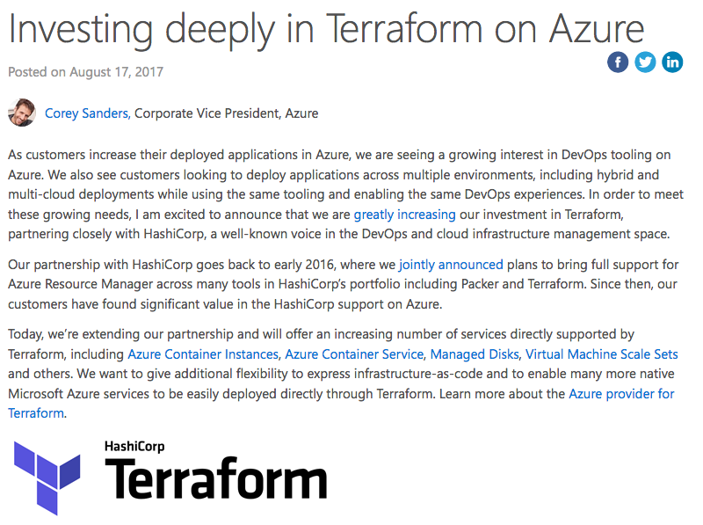
Microsoft <3 Terraform
Microsoft Investing in Terraform
Azure Container Instance
Azure Kubernetes Service
https://aka.ms/terraform
https://aka.ms/terraformdocs
https://azure.microsoft.com/en-us/blog/investing-deeply-in-terraform-on-azure/
Notes:
2017, Hashicorp and Microsoft official partners.
Terraform is a first class citizen in Azure
Azurerm new resources quickly
ACI – GA
AKS – Preview
Event Grid - ~1 week

Slide 50
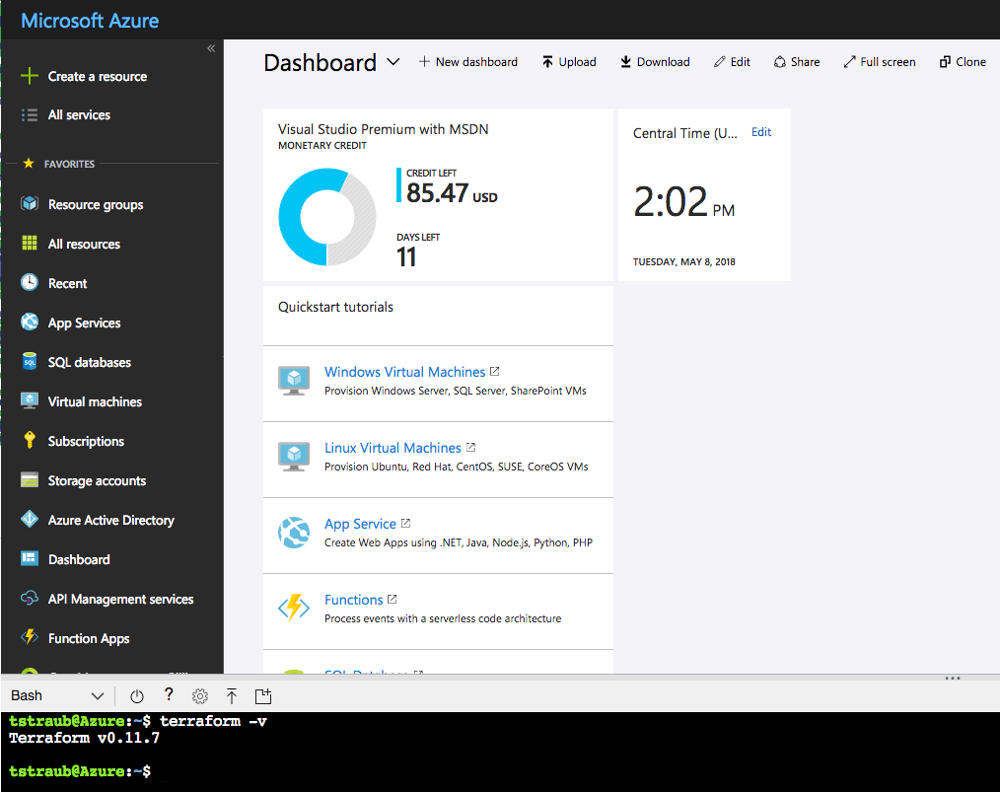
Microsoft <3 Terraform
Azure Cloud Shell Integration
https://docs.microsoft.com/en-us/azure/terraform/terraform-cloud-shell
Notes:
Latest version of Terraform.
Can run Terraform from the Azure Cloud Shell – WILL DEMO THIS LATER

Slide 51
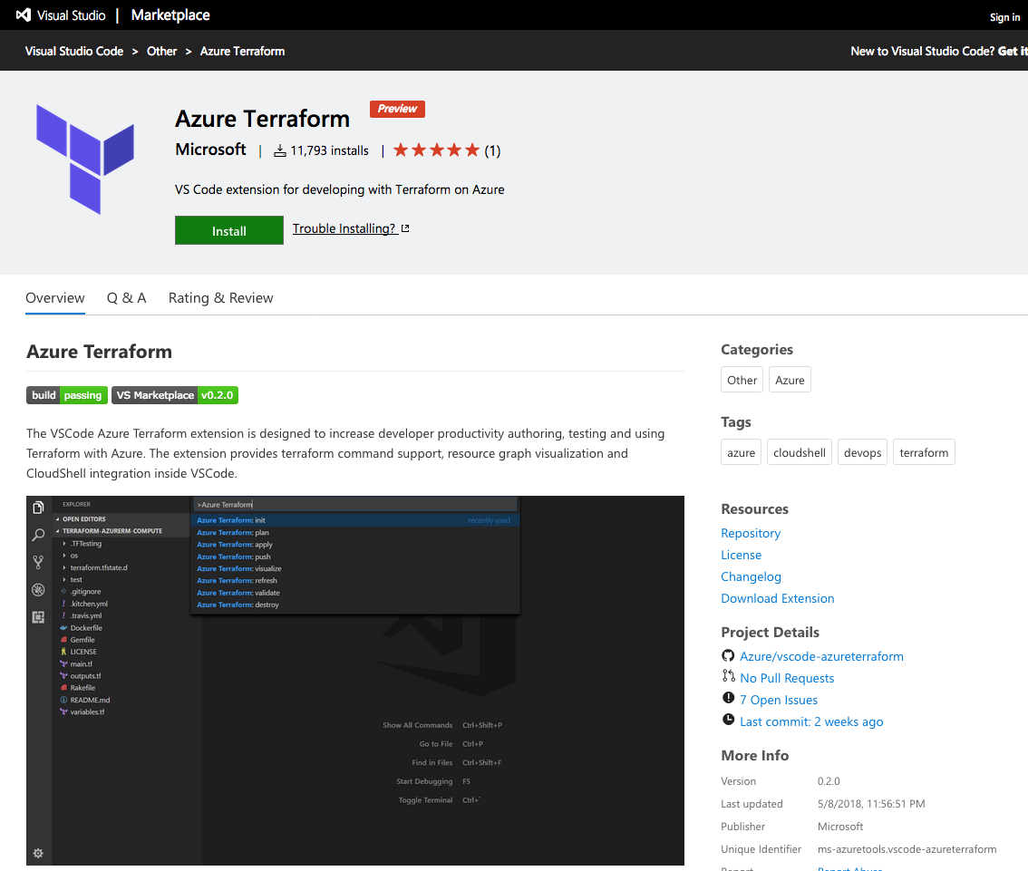
Microsoft <3 Terraform
VS Code Extension
https://docs.microsoft.com/en-us/azure/terraform/terraform-cloud-shell
Notes:
Integrates with the Azure Cloud Shell
Allows pushing local code to the Cloud Shell
Preview

Slide 52
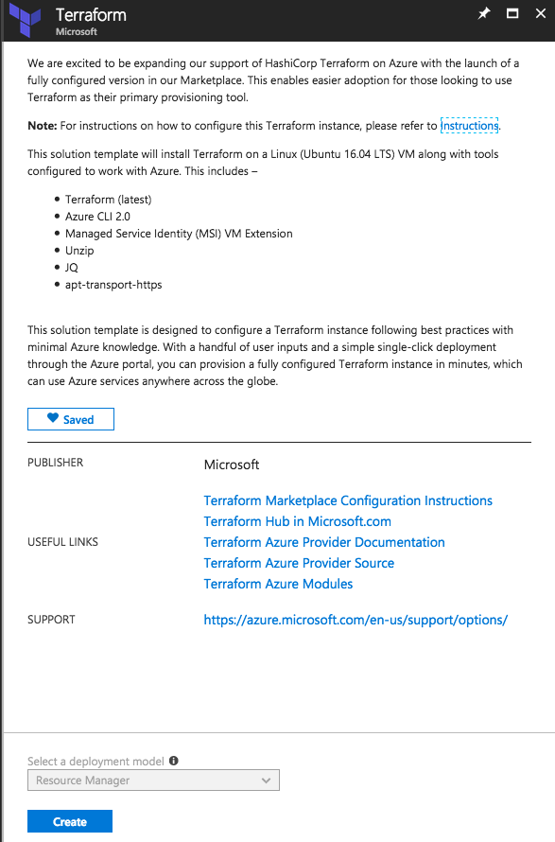
Microsoft <3 Terraform
Terraform Marketplace Image
Creates a VM with system-assigned identity that's based on the Ubuntu 16.04 LTS image.
Installs the MSI extension on the VM to allow OAuth tokens to be issued for Azure resources.
Assigns RBAC permissions to the managed identity, granting owner rights for the resource group.
Creates a Terraform template folder (tfTemplate).
Pre-configures a Terraform remote state with the Azure back end.
https://aka.ms/aztfmkt
Notes:
Remote State Backend
Managed Service Identity – handles OATH

Slide 53
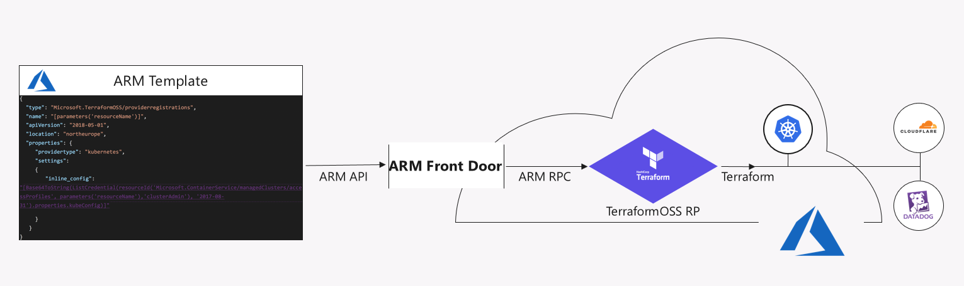
Microsoft <3 Terraform
Terraform 3rd Party Azure Provider
https://azure.microsoft.com/en-us/blog/introducing-the-azure-terraform-resource-provider/
Notes:
Terraform built-in provider

Slide 54
Break
Notes:
[50m]

Slide 55
Terraform

Slide 56


Terraform
https://www.terraform.io/
Open Source Software
https://github.com/hashicorp/terraform
Written in GO
https://golang.org/
Notes:
OSS, hosted on Github
GoLang – single executable

Slide 57
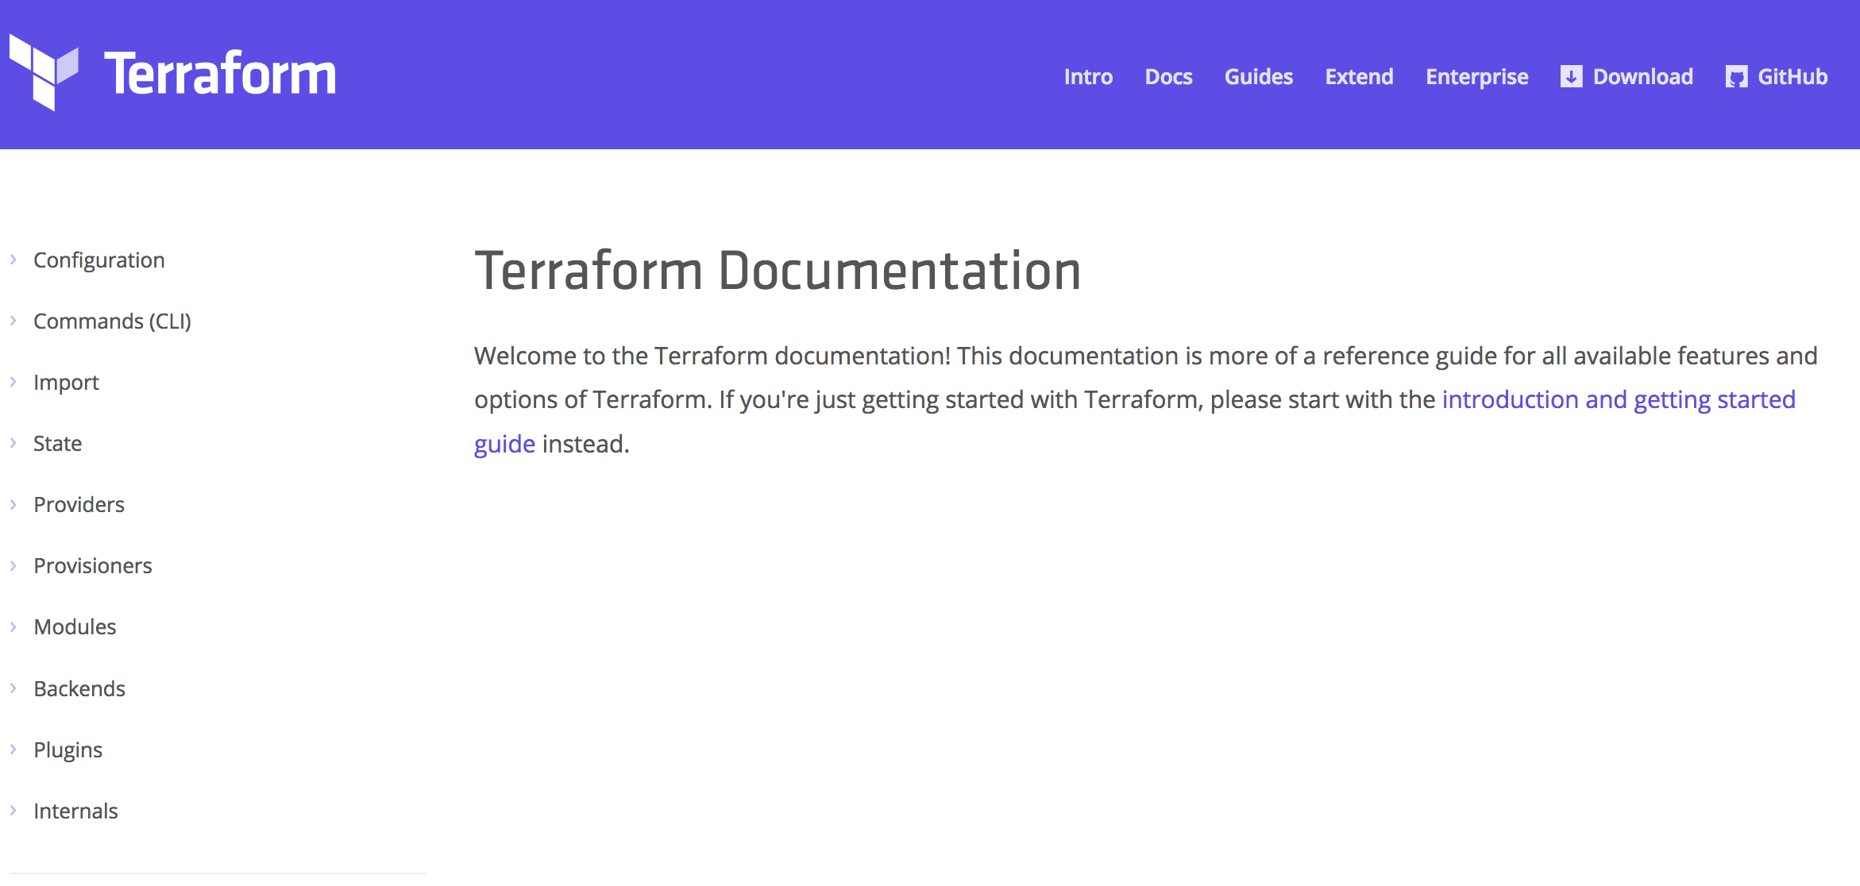
Terraform Documentation
https://www.terraform.io/docs
Notes:
Great documentation.
Constantly being updated.

Slide 58
Provision any infrastructure for any application
Core
Azure

Slide 59
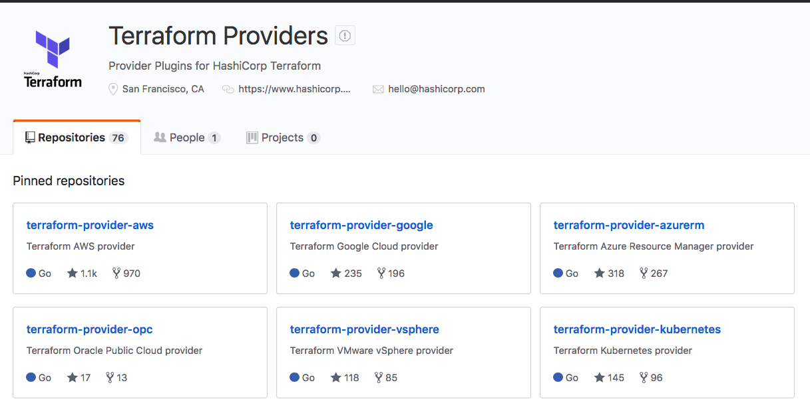
Terraform Providers
https://github.com/terraform-providers
Notes:
Terraform Providers are in their own Github Organization
Terraform only pulls in what is needed based on your configuration `terraform init`
Aka.ms/terraform

Slide 60
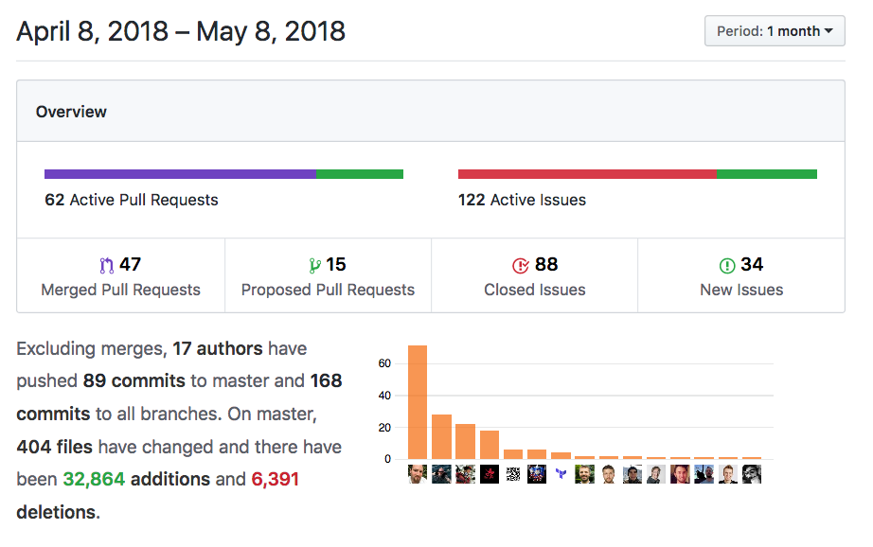
Azure Provider
100+ resources
Very active code base
Frequent releases
Jan 2018 -> v1.0.0
May 2018 -> v1.4.0
Great visibility into progress
https://github.com/terraform-providers/terraform-provider-azurerm
Notes:
100+ resources, more added every week.
Active code base – 47 Merged PR in 1 month
Frequent releases - 10 official releases in 5 months
Actively see what is being progress (Submit an Issue if you have a problem)

Slide 61
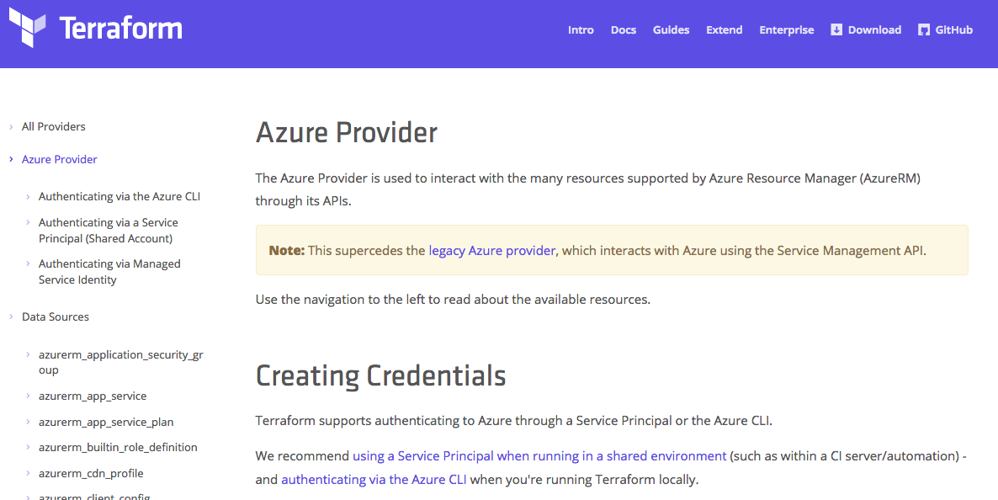
Azure Provider Documentation
https://www.terraform.io/docs/providers/azurerm

Slide 62
Hashicorp Configuration Language
Human-readable configuration (HCL) is designed for human consumption so users can quickly interpret and understand their infrastructure configuration.
HCL includes a full JSON parser for machine-generated configurations.
https://github.com/hashicorp/hcl

Slide 63
main.tf
resource "azurerm_resource_group" "myfirstrg" {
name = "myfirstresourcegroup"
location = ”eastus"
}
Notes:
‘resource’ is a TF Core type
‘azurerm_resource_group’ is an AzureRM provider resource.
‘myfirstrg’ is a scoping name to the resource (for planning, etc…)
‘name’ and ‘location’ are parameters set for a resource.
https://www.terraform.io/docs/configuration/syntax.html

Slide 64
Terraform in Action

Slide 65
Terraform Workflow
Init
Plan
Core
Provider
Apply
Notes:
Walk through the workflow
Only *.tf files that are in the current directory (nothing nested).
Init – happens once, pull dependencies
Plan

Slide 66
DEMO
Notes:
DEMO the basic init/plan/apply from the Azure Cloud Shell
Next few slides are back up/reference.

Slide 67
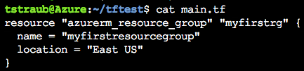
Notes:
Consider a simple resource group

Slide 68
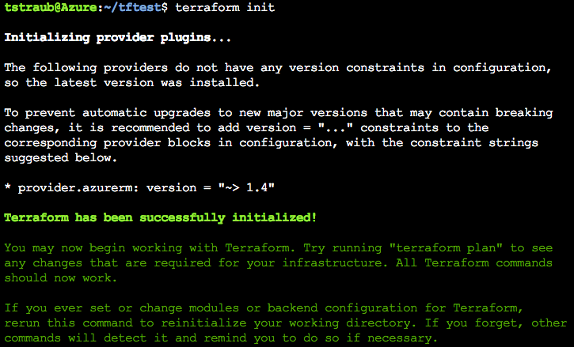
Notes:
Init
Reads configuration
initialize providers
Loads state file

Slide 69
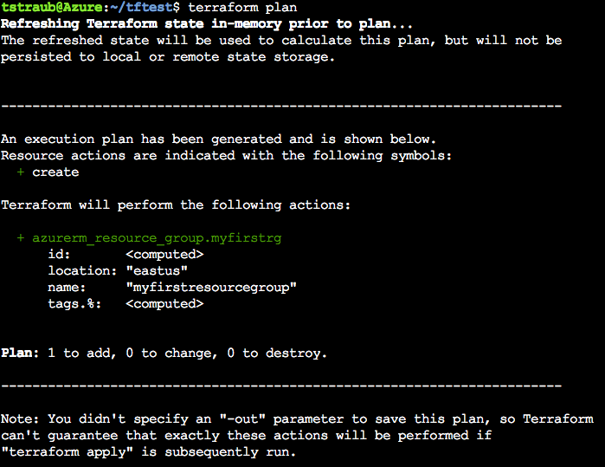
Notes:
Plan
Determines what infrastructure is needed and displays it

Slide 70
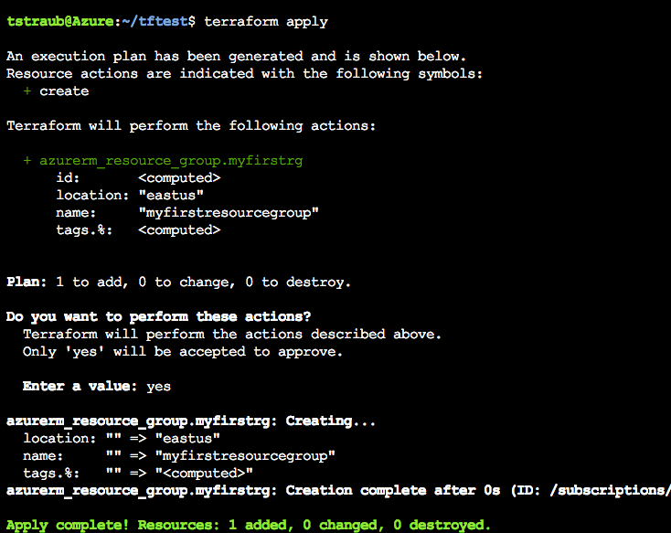
Notes:
Apply
Reruns a plan and prompts for confirmation before continuing
‘yes’ -> Applies the configuration

Slide 71
Terraform Configuration

Slide 72
Terraform
terraform {
required_version = "= 0.11.7"
}
= | Exact version equality | = 0.11.7
!= | Exclude version | != 0.11.6
> >= < <= | Version comparison | >= 0.11.4
~> | Pessimistic constraint | ~> 0.11.7
https://www.terraform.io/docs/configuration/terraform.html
Notes:
Not required.
Version pinning, good idea in production.
= is optional, defaults
Pessimistic will go up until the next major version

Slide 73
AzureRm Provider
provider "azurerm" {
version = ”= 1.4.0"
}
https://www.terraform.io/docs/providers/azurerm/index.html
Notes:
Specify the version
Same as terraform but for the provider.
Same compare rules.

Slide 74
Authentication to Azure
Azure CLI
az login
Uses your own credentials
Great for local development
Also how the Azure Cloud Shell works
Notes:
Great for testing
Can use this today, but since we will need the SP later, go ahead and create it

Slide 75
Authentication to Azure
Service Principal
Preferred for shared environments
Works well in automation
Also how Terraform Enterprise works
Notes:
You will generate these on your subscription in the challenges

Slide 76
Authentication to Azure
Service Principal
provider "azurerm" {
version = "1.4.0"
subscription_id = "SUBSCRIPTION-ID"
client_id = "CLIENT-ID"
client_secret = "CLIENT-SECRET"
tenant_id = "TENANT-ID"
}
Notes:
Can set them in the configuration

Slide 77
Authentication to Azure
Service Principal
export ARM_TENANT_ID=
export ARM_SUBSCRIPTION_ID=
export ARM_CLIENT_ID=
export ARM_CLIENT_SECRET=
Notes:
Preferred method
Easiest to blend into automation
How Terraform Enterprise will get these values.

Slide 78
Azure Location
resource "azurerm_resource_group" "main" {
location = "eastus"
}
resource "azurerm_resource_group" "main" {
location = “East US”
}
Notes:
Location equivalent
Pick either format, just be consistent
We use `eastus` in this workshop

Slide 79
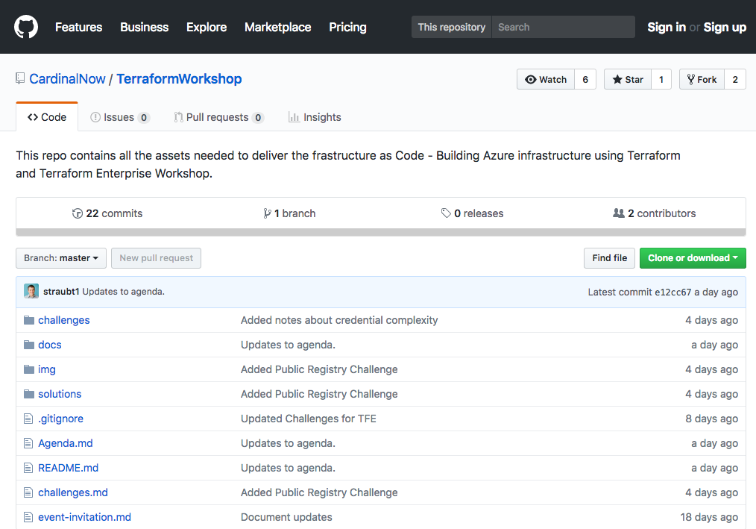
Workshop Repo
https://github.com/CardinalNow/TerraformWorkshop
Notes:
Walk through Repo

Slide 80
Challenge
00 - Getting Started
01 - Connecting to Azure
Notes:
30-45 mins Walk through the challenges
Setup Environment
Connect to the Azure CLI
Create a Resource Group
Goal: get setup/connected/building infrastructure
Combine this as a break

Slide 81
Challenge
00 - Getting Started
01 - Connecting to Azure
Notes:
How did it go?

Slide 82
Terraform State

Slide 83
Terraform State
File that stores state about your managed infrastructure
Keeps track of resource metadata
Used to map real world resources to your configuration.
Local terraform.tfstate file by default
https://www.terraform.io/docs/state

Slide 84
Terraform State
Config: Desired State
State: Current State
Diff: Delta of {Desired & Current}
Plan: Presents Diff
Apply: Resolves Diff
https://www.terraform.io/docs/state/remote.html

Slide 85
Terraform State
https://www.terraform.io/docs/state/remote.html
Notes:
Connecting these 3 points.

Slide 86

Terraform State
State file can contain sensitive data
https://www.terraform.io/docs/state/sensitive-data.html
Notes:
Do not store in source control
Such as usernames, passwords, keys…
Encrypted at rest in Azure storage accounts

Slide 87
Terraform State - Remote
Remote state
Backend
Local is default
Teams/collab
In memory state only
https://www.terraform.io/docs/state/remote.html

Slide 88
Terraform State – Operations
Configuration | State | Reality | Operation
azurerm_virtual_machine.app
https://www.terraform.io/docs/state/remote.html

Slide 89
Terraform State – Operations
Configuration | State | Reality | Operation
azurerm_virtual_machine.app |  |  | CREATE
https://www.terraform.io/docs/state/remote.html

Slide 90
Terraform State – Operations
Configuration | State | Reality | Operation
azurerm_virtual_machine.app |  |  | CREATE
azurerm_virtual_machine.app | azurerm_virtual_machine.app
https://www.terraform.io/docs/state/remote.html

Slide 91
Terraform State – Operations
Configuration | State | Reality | Operation
azurerm_virtual_machine.app |  |  | CREATE
azurerm_virtual_machine.app | azurerm_virtual_machine.app |  | CREATE
https://www.terraform.io/docs/state/remote.html

Slide 92
Terraform State – Operations
Configuration | State | Reality | Operation
azurerm_virtual_machine.app |  |  | CREATE
azurerm_virtual_machine.app | azurerm_virtual_machine.app |  | CREATE
azurerm_virtual_machine.app | azurerm_virtual_machine.app | azurerm_virtual_machine.app
https://www.terraform.io/docs/state/remote.html

Slide 93
Terraform State – Operations
Configuration | State | Reality | Operation
azurerm_virtual_machine.app |  |  | CREATE
azurerm_virtual_machine.app | azurerm_virtual_machine.app |  | CREATE
azurerm_virtual_machine.app | azurerm_virtual_machine.app | azurerm_virtual_machine.app | NOOP
https://www.terraform.io/docs/state/remote.html

Slide 94
Terraform State – Operations
Configuration | State | Reality | Operation
azurerm_virtual_machine.app |  |  | CREATE
azurerm_virtual_machine.app | azurerm_virtual_machine.app |  | CREATE
azurerm_virtual_machine.app | azurerm_virtual_machine.app | azurerm_virtual_machine.app | NOOP
 | azurerm_virtual_machine.app | azurerm_virtual_machine.app
https://www.terraform.io/docs/state/remote.html

Slide 95
Terraform State – Operations
Configuration | State | Reality | Operation
azurerm_virtual_machine.app |  |  | CREATE
azurerm_virtual_machine.app | azurerm_virtual_machine.app |  | CREATE
azurerm_virtual_machine.app | azurerm_virtual_machine.app | azurerm_virtual_machine.app | NOOP
 | azurerm_virtual_machine.app | azurerm_virtual_machine.app | DELETE
https://www.terraform.io/docs/state/remote.html

Slide 96
Terraform State – Operations
Configuration | State | Reality | Operation
azurerm_virtual_machine.app |  |  | CREATE
azurerm_virtual_machine.app | azurerm_virtual_machine.app |  | CREATE
azurerm_virtual_machine.app | azurerm_virtual_machine.app | azurerm_virtual_machine.app | NOOP
 | azurerm_virtual_machine.app | azurerm_virtual_machine.app | DELETE
 |  | azurerm_virtual_machine.app
https://www.terraform.io/docs/state/remote.html

Slide 97
Terraform State – Operations
Configuration | State | Reality | Operation
azurerm_virtual_machine.app |  |  | CREATE
azurerm_virtual_machine.app | azurerm_virtual_machine.app |  | CREATE
azurerm_virtual_machine.app | azurerm_virtual_machine.app | azurerm_virtual_machine.app | NOOP
 | azurerm_virtual_machine.app | azurerm_virtual_machine.app | DELETE
 |  | azurerm_virtual_machine.app | NOOP
https://www.terraform.io/docs/state/remote.html

Slide 98
Terraform State – Operations
Configuration | State | Reality | Operation
azurerm_virtual_machine.app |  |  | CREATE
azurerm_virtual_machine.app | azurerm_virtual_machine.app |  | CREATE
azurerm_virtual_machine.app | azurerm_virtual_machine.app | azurerm_virtual_machine.app | NOOP
 | azurerm_virtual_machine.app | azurerm_virtual_machine.app | DELETE
 |  | azurerm_virtual_machine.app | NOOP
azurerm_virtual_machine.app |  | azurerm_virtual_machine.app
https://www.terraform.io/docs/state/remote.html

Slide 99
Terraform State – Operations
Configuration | State | Reality | Operation
azurerm_virtual_machine.app |  |  | CREATE
azurerm_virtual_machine.app | azurerm_virtual_machine.app |  | CREATE
azurerm_virtual_machine.app | azurerm_virtual_machine.app | azurerm_virtual_machine.app | NOOP
 | azurerm_virtual_machine.app | azurerm_virtual_machine.app | DELETE
 |  | azurerm_virtual_machine.app | NOOP
azurerm_virtual_machine.app |  | azurerm_virtual_machine.app | RECREATE
https://www.terraform.io/docs/state/remote.html

Slide 100
Terraform State – Operations
Configuration | State | Reality | Operation
azurerm_virtual_machine.app |  |  | CREATE
azurerm_virtual_machine.app | azurerm_virtual_machine.app |  | CREATE
azurerm_virtual_machine.app | azurerm_virtual_machine.app | azurerm_virtual_machine.app | NOOP
 | azurerm_virtual_machine.app | azurerm_virtual_machine.app | DELETE
 |  | azurerm_virtual_machine.app | NOOP
azurerm_virtual_machine.app |  | azurerm_virtual_machine.app | RECREATE
 | azurerm_virtual_machine.app
https://www.terraform.io/docs/state/remote.html

Slide 101
Terraform State – Operations
Configuration | State | Reality | Operation
azurerm_virtual_machine.app |  |  | CREATE
azurerm_virtual_machine.app | azurerm_virtual_machine.app |  | CREATE
azurerm_virtual_machine.app | azurerm_virtual_machine.app | azurerm_virtual_machine.app | NOOP
 | azurerm_virtual_machine.app | azurerm_virtual_machine.app | DELETE
 |  | azurerm_virtual_machine.app | NOOP
azurerm_virtual_machine.app |  | azurerm_virtual_machine.app | RECREATE
 | azurerm_virtual_machine.app |  | REMOVE FROM STATE
https://www.terraform.io/docs/state/remote.html

Slide 102
Variables

Slide 103
Variables
variable "location" {
default = ”eastus"
description = ”Location to deploy Azure Infrastructure"
}
resource "azurerm_resource_group" "module" {
name = ”my-rg"
location = "${var.location}"
}
https://www.terraform.io/docs/configuration/variables.html
Notes:
Can be default or else required.
Default are literal and can not be interpolated.
Type is assumed.
Interpolation, more to come, VERY powerful
Description is purely for documentation (TF Registry)

Slide 104
Variables - Types
variable "key" {
type = "string"
default = "value"
}
https://www.terraform.io/docs/configuration/variables.html

Slide 105
Variables - Types
variable "images" {
type = "map"
default = {
"dev" = "image1"
"test" = "image2"
"prod" = "image3"
}
}
https://www.terraform.io/docs/configuration/variables.html
Notes:
Can be fragile

Slide 106
Variables - Types
variable "rules" {
type = "list"
default = ["rule1", "rule2"]
}
https://www.terraform.io/docs/configuration/variables.html

Slide 107
Variables - Types
variable "enabled" {
default = false
}
https://www.terraform.io/docs/configuration/variables.html

Slide 108
Variables - Scoping
Variables are valid within the current module level.
test
├── app1.tf
├── app2.tf
└── variables.tf
https://www.terraform.io/docs/configuration/variables.html
Notes:
All files can declare and use variables.
Share the same scope.
Can not duplicate.
Revisit when we reach modules.

Slide 109
Variables – How to Use
Defaults
https://www.terraform.io/docs/configuration/variables.html
Notes:
Already shown

Slide 110
Variables – How to Use
Variable Files
terraform.tfvars
*.auto.tfvars
terraform plan -var-file=vars.tfvars
foo = "bar"
valid = true
somelist = [
"one",
"two",
]
https://www.terraform.io/docs/configuration/variables.html

Slide 111
Variables – How to Use
Command Line Parameters
terraform plan –var ‘foo=bar’
terraform plan –var ‘foo=bar’ –var ‘bar=foo’
https://www.terraform.io/docs/configuration/variables.html
Notes:
Pass as many as you like
Duplicates will be overridden.

Slide 112
Variables – How to Use
Environment Variables (TF_VAR_*)
export TF_VAR_foo=bar
export TF_VAR_bar=foo
https://www.terraform.io/docs/configuration/variables.html
Notes:
Great for automation.

Slide 113
Outputs

Slide 114
Outputs
Outputs define useful values that will be highlighted to the user when Terraform applies:
IP addresses
Usernames
Computed Values
Easily extract and query information from all resources
https://www.terraform.io/docs/configuration/outputs.html
Notes:
Each resource has a lot of metadata, showing it all would be too difficult to sort through.
Computed Values (dynamic IPs)
Customized outputs

Slide 115
Outputs
output "vm_private_ips" {
value = "${azurerm_network_interface.app.private_ip_address}”
description = "Dynamic Private IP Addresses”
}
.
https://www.terraform.io/docs/configuration/outputs.html

Slide 116
Outputs
Outputs:
vm_private_ips = [
10.0.0.1,
10.0.0.2,
10.0.0.3
]
Notes:
Clean up this slde
`terraform refresh` when outputs change.
`terraform output` to view.

Slide 117
Challenge
02 - Provision Azure Container Instance
Notes:
Create an ACI

Slide 118
Interpolations

Slide 119
Interpolations
Embedded within strings in Terraform you can interpolate other values.
"${var.name}-rg"
The interpolation syntax is powerful and allows you to reference variables, attributes of resources, call functions, etc.
https://www.terraform.io/docs/configuration/interpolation.html

Slide 120
Interpolations – Count
variable "count" {
default = 2
}
resource "azurerm_network_interface" "web" {
name = "nic-${count.index}"
count = "${var.count}"
}
resource "azurerm_virtual_machine" "web" {
count = "${var.count}"
network_interface_ids = ["${element(azurerm_network_interface.web.*.id, count.index)}"]
}
Notes:
One of the most important!
count.index scoped to resource

Slide 121
Interpolations - Conditionals
resource "azurerm_virtual_machine" "web" {
subnet = "${var.size == "small" ? var.small_vm : var.large_vm}"
}
.
https://www.terraform.io/docs/configuration/interpolation.html

Slide 122
Interpolations – Built-In Functions
concat(list1, list2, ...) - Combines two or more lists into a single list.
concat(var.base_tags, var.additional_tags)
element(list, index) - Returns a single element from a list at the given index.
element(azurerm_subnet.foo.*.id, count.index)
element(var.list_of_strings, 2)
https://www.terraform.io/docs/configuration/interpolation.html
Notes:
Element() If the index is greater than the number of elements, this function will wrap using a standard mod algorithm.

Slide 123
Interpolations – Built-In Functions
format(format, args, ...) - Formats a string according to the given format. The syntax for the format is standard sprintf syntax.
Example to zero-prefix a count, used commonly for naming servers
format("web-%03d", 2).
https://www.terraform.io/docs/configuration/interpolation.html
Notes:
Format, for index =2 -> “web-002”

Slide 124
Interpolations – Math
resource "azurerm_virtual_machine" "module" {
name = "myvm-${count.index + 1}"
}
resource "azurerm_virtual_machine" "module" {
name = "${format("myvm-%03d", count.index + 1)}"
}
https://www.terraform.io/docs/configuration/interpolation.html

Slide 125
Interpolations – locals
variable "name" {
default = "dev"
}
locals {
module_name = "${var.name}-sql"
}
https://www.terraform.io/docs/configuration/locals.html
Notes:
Private variable

Slide 126
Modules

Slide 127
Modules
Root module:
The current working directory when you run terraform init/plan/apply, holding the Terraform configuration files.
It is itself a valid module.
Variable scoping:
Variables are scoped only to the module in which they are declared. There is no inheritance!
Notes:
You have been using modules all along.
Variable scoping.

Slide 128
Modules
Notes:
Detail the variable scoping
Too detailed, ignoring this diagram.

Slide 129
Module Usage
module ”mymodule" {
source = ”path/to/module"
name = "mysuperapp"
...
}
https://www.terraform.io/docs/modules

Slide 130
Module Sources
Local
Github
Generic git repo
Bitbucket
HTTP URLs
Registry (support versioning)
https://www.terraform.io/docs/modules/sources.html

Slide 131
Module Usage
module "windowsservers" {
source = "Azure/compute/azurerm"
version = "1.1.5"
location = ”eastus"
vm_hostname = "mywinvm"
vm_os_simple = "WindowsServer"
}
https://www.terraform.io/docs/modules

Slide 132
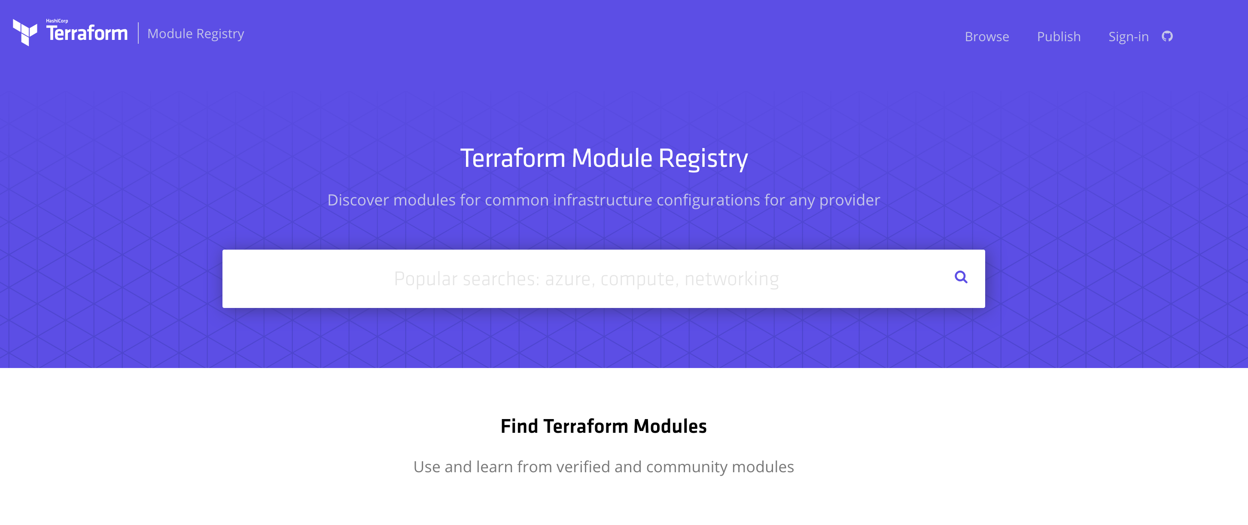
Public Module Registry
https://registry.terraform.io

Slide 133
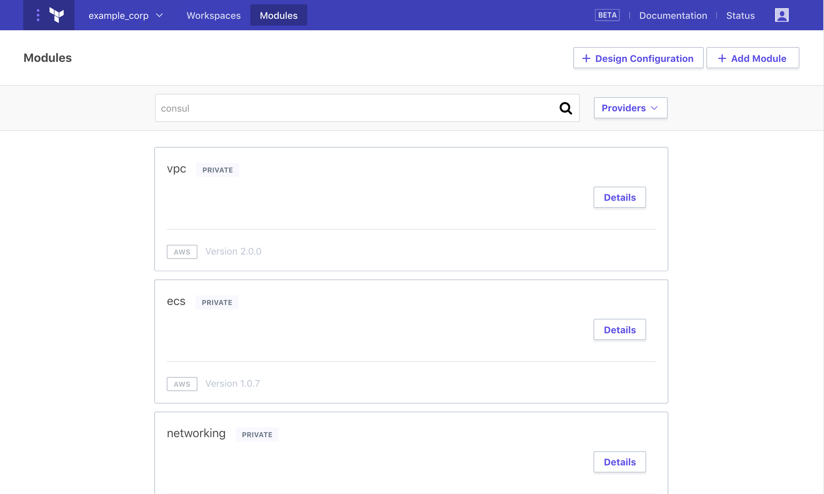
Private Module Registry
https://www.terraform.io/docs/enterprise/registry
Notes:
Terraform Enterprise

Slide 134
Backend

Slide 135
Backend
Determines how state is loaded and how an operations are executed.
Enables non-local file state storage, remote execution, etc.
By default, Terraform uses the "local" backend.
https://www.terraform.io/docs/backends/types/index.html
Notes:
Use common state across others.

Slide 136
Backend- azurerm
terraform {
backend "azurerm" {
storage_account_name = "myorgeastus8x76ghf"
container_name = "terraformstate"
key = "dev.terraform.tfstate"
}
}
https://www.terraform.io/docs/backends/types/index.html

Slide 137
Backend
State Locking – Allows for teams to work together.
Backend Types:
azure SA
artifactory
Consul
Terraform Enterprise Manages this for you!!
https://www.terraform.io/docs/backends/types/index.html
Notes:
Independent of Terraform Provider
Consul
Consul value max = 512KB.

Slide 138
Terraform Internals

Slide 139
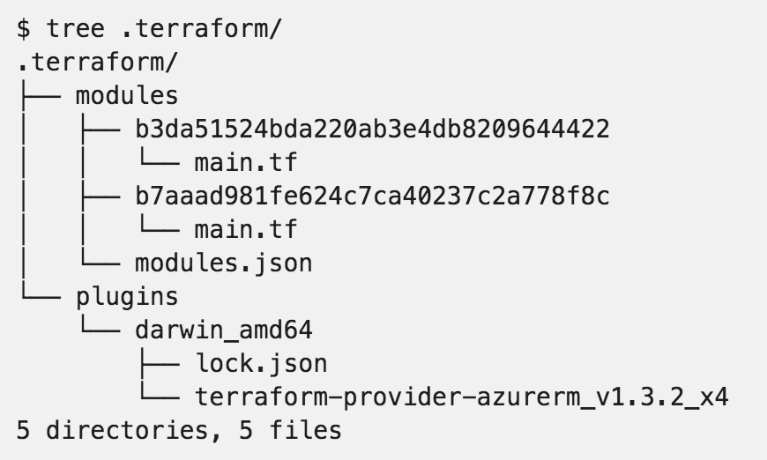
.terraform

Slide 140
Resource Addressing
Resource Address:
<MODULE PATH><RESOURCE SPEC>
azurerm_resource_group.module
module.A.azurerm_network_interface.web
https://www.terraform.io/docs/internals/resource-addressing.html

Slide 141
Resource Addressing
Module Path:
Addresses a module within a tree of modules.
module.A…
Can be multiple levels deep
module.A.module.B…
https://www.terraform.io/docs/internals/resource-addressing.html

Slide 142
Resource Addressing
Resource Spec:
resource_type.resource_name[N]
resource_type - Type of the resource being addressed.
resource_name - User-defined name of the resource.
[N] - where N is a 0-based index into a resource with multiple instances specified by the count meta-parameter.
https://www.terraform.io/docs/internals/resource-addressing.html

Slide 143
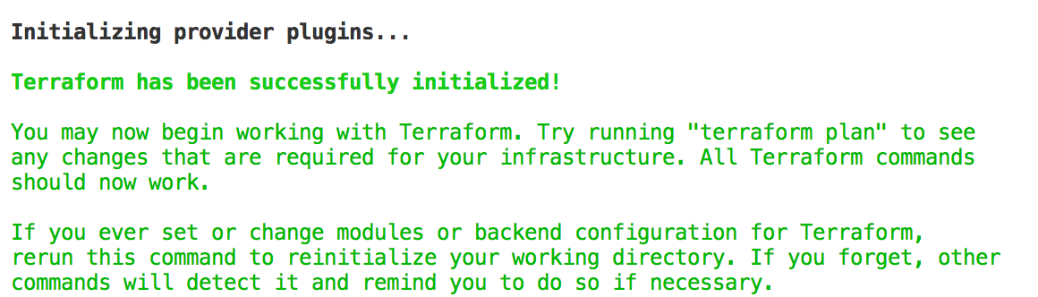
Commands - init
Usage: terraform init [options] [DIR]
https://www.terraform.io/docs/commands/init.html
Notes:
Can specify a DIR, but not recommended.

Slide 144
Commands - plan
Usage: terraform plan [options] [DIR-OR-PLAN]
Options:
-destroy If set, a plan will be generated to destroy all resources managed by the given configuration and state.
-parallelism=n Limit the number of concurrent operations. Defaults to 10.
-target=resource Resource to target.
https://www.terraform.io/docs/commands/plan.html

Slide 145
Commands - plan
Options:
-out=path Write a plan file to the given path.
-var 'foo=bar' Set a variable in the Terraform configuration. This flag can be set multiple times.
-var-file=foo Set variables in the Terraform configuration from a file.
https://www.terraform.io/docs/commands/plan.html

Slide 146
Commands - apply
Usage: terraform apply [options] [DIR-OR-PLAN]
https://www.terraform.io/docs/commands/apply.html

Slide 147
Commands - destroy
Usage: terraform destroy [options] [DIR]
https://www.terraform.io/docs/commands/destroy.html

Slide 148
Commands - fmt
Rewrites all Terraform configuration files in the current working directory.
Usage: terraform fmt [options] [DIR]
Options:
-check=false Check if the input is formatted. Exit status will be 0 if all input is properly formatted and non-zero otherwise.
https://www.terraform.io/docs/commands/fmt.html
Notes:
-check, great for CI server checks.

Slide 149
Commands - validate
Usage: terraform validate [options] [dir]
Validate the terraform files in a directory. Validation includes a basic check of syntax as well as checking that all variables declared in the configuration are specified.
https://www.terraform.io/docs/commands/validate.html

Slide 150
Commands - refresh
Usage: terraform refresh [options] [dir]
Update the state file of your infrastructure with metadata that matches the physical resources they are tracking.
This will not modify your infrastructure, but it can modify your state file to update metadata. This metadata might cause new changes to occur when you generate a plan or call apply next.
https://www.terraform.io/docs/commands/refresh.html

Slide 151
Commands - output
Usage: terraform output [options] [NAME]
Options:
-module=name If specified, returns the outputs for a specific module
-json If specified, machine readable output will be printed in JSON format
https://www.terraform.io/docs/commands/output.html

Slide 152
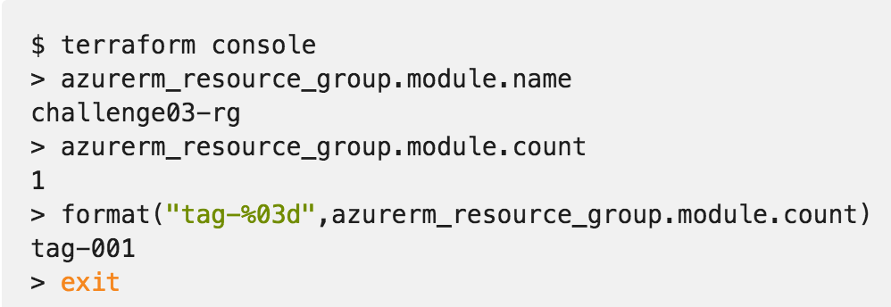
Commands - console
Creates an interactive console for interacting with Terraform.
Useful for experimenting with interpolations
and interacting with Terraform state.
https://www.terraform.io/docs/commands/console.html
Notes:
Doesn’t modify state
Can read remotes
Can work with out a state (just nothing to query)

Slide 153
Commands - graph
Usage: terraform graph [options] [DIR]
Outputs the visual execution graph of Terraform resources according to configuration files in DIR (or the current directory if omitted).
The graph is outputted in DOT format.
https://www.terraform.io/docs/commands/graph.html

Slide 154
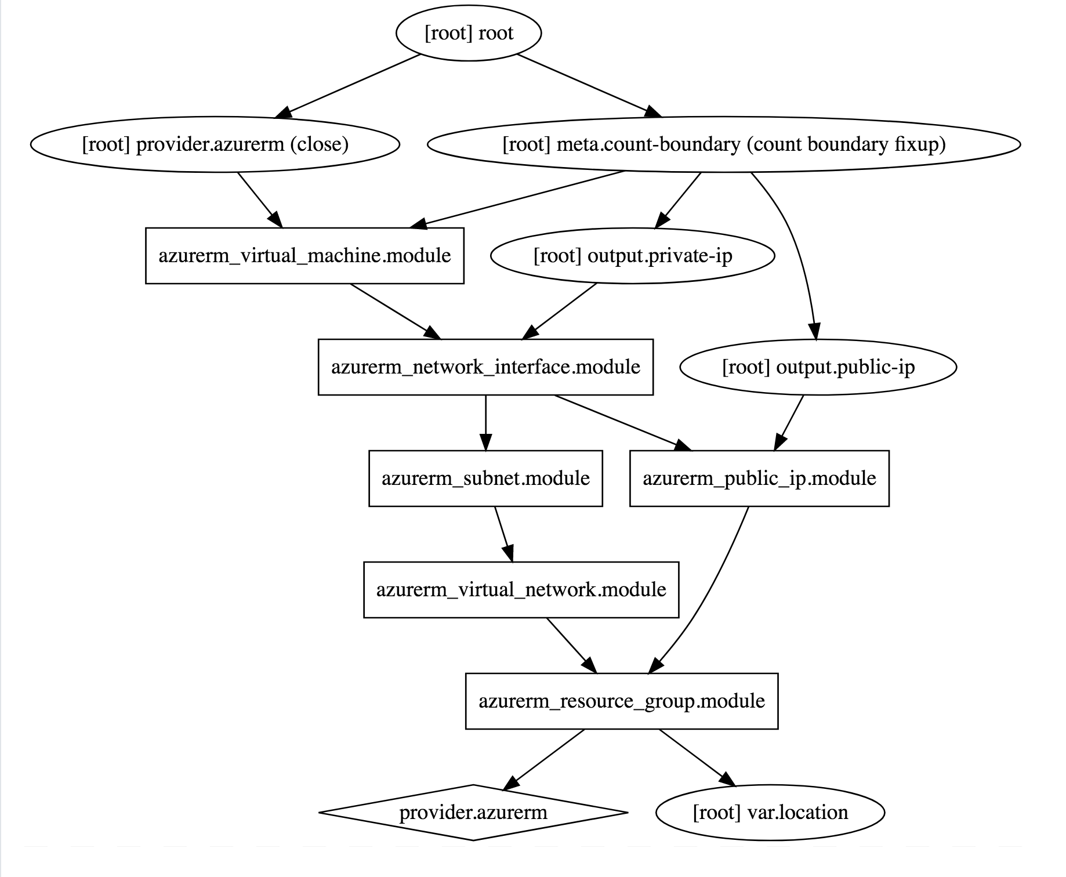
Commands - graph
terraform graph |
dot -Tsvg > graph.svg
https://www.terraform.io/docs/commands/graph.html

Slide 155
Advanced Commands
- state (list, mv, pull, push, rm, show)
- import
- taint/untaint

Slide 156
Challenge
06 – Public Module Registry
Notes:
Standup a Virtual Machine using the MS verified module.

Slide 157
Challenge
03 - Provision Azure Virtual Machines
04 - Scaling Infrastructure with Count
Notes:
Create a Virtual Machine step by step.
Scale the Virtual Machine.

Slide 158
Challenge
05 – Using Modules
06 – Public Module Registry
Notes:
Using modules

Slide 159
Terraform Enterprise

Slide 160
Terraform Open Source and Terraform Enterprise
OSS for technical complexity & Enterprise for organizational complexity
Governance
Organizational Complexity
Gold Support
Collaboration
Collaboration
Silver Support
Provisioning
Provisioning
Provisioning
Individuals use
OSS
Teams use
Pro
Organizations use
Premium
Notes:
Open Source:
IaC
Workflow (plan/apply)
Public Module Registry
Enterprise Pro:
Workspace Management GUI
VC Connections
Private Module Registry
SaaS
Enterprise Premium:
Private Install option
Policy as Code
Audit Logs

Slide 161
Terraform Open Source and Terraform Enterprise
OSS for technical complexity & Enterprise for organizational complexity
Governance
Organizational Complexity
Gold Support
Collaboration
Collaboration
Silver Support
Provisioning
Provisioning
Provisioning
Individuals use
OSS
Teams use
Pro
Organizations use
Premium
Notes:
The foundation of Terraform is the open source project and addresses the concern for individuals:
use infrastructure as code to create reusable configuration, enable automation, and manage infrastructure in cloud, at scale
use a consistent workflow for many different infrastructure providers to safely and consistently provision infrastructure and without having to learn other provision and management tools
As Terraform adoption grows beyond 1 or 2 users (which is how it generally begins) and as the organizational structure of infrastructure management grows there are a set of requirements around collaboration and governance that become helpful to using Terraform at scale for your organization.
Additionally to this, there is also the element of support for daily and long term success through enterprise levels of support. This includes both on-call support for daily issues but also long-terms architecture guidance and technical account management. This is what is offered as part of Terraform Enterprise. The focus of the Terraform Enterprise Pro is collaboration and the Terraform Enterprise Premium is governance.

Slide 162
Terraform OSS workflow for individuals
DEVELOPER
OPERATOR
VCS
Notes:
For collaboration, lets take a quick look back at the OSS workflow.
In this scenario there is 1 or 2 individuals using Terraform configurations to create and update the infrastructure.
And this is relatively simple to coordinate these changes.
However as more operators become proficient using Terraform and are brought on to help provision large scale infrastructures tis models expands.

Slide 163
How can teams safely collaborate on infrastructure
DEVELOPERS
OPERATORS
VCS
Notes:
Now there are multiple operators creating Terraform configurations, and in the case of more complex infrastructure one operator might be responsible for the networking infrastructure, and one operator responsible for the core infrastructure, and one operator responsible for web properties, etc.
Additionally, to this more operators are starting to consume the infrastructure provisioned by Terraform for their various different applications. The coordination of all of these runs is not trivial, each users is running their private installation of Terraform and updating the same infrastructure.

Slide 164
Workspaces

Slide 165
Workspace management and VCS connection
INFRASTRUCTURE AS CODE
DEVELOPERS
OPERATORS
Core
Provider
VCS
Notes:
To address this Terraform Enterprise provides Terraform Workspace management and UI with remote state storage, plans, and applies to remove the challenge of coordination.
Terraform Enterprise Workspaces has an API by design approach making it easy for you to integrate into your environment and existing tooling.
Workspaces are connected to Version control system repositories
Workspaces can be created in a granular way to align with how the infrastructure is organized. For example, workspaces can be organized by the stage of application delivery (development/test/production) and/or the type of infrastructure (networking/compute/monitoring/web).
Developer can use a private version of a module registry in the Terraform Enterprise UI to search for pre-defined modules to spin up infrastructure to run their applications.

Slide 166
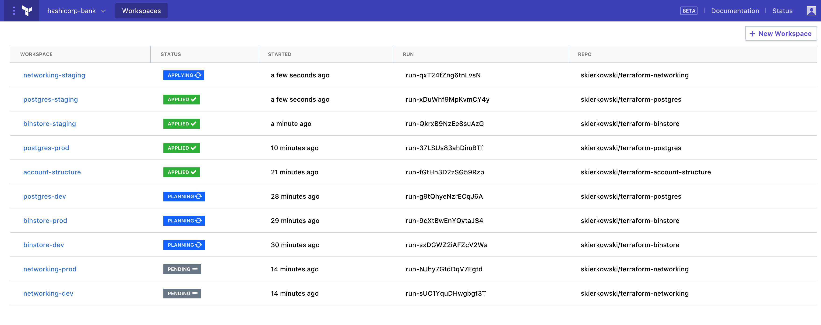
Workspace management and VCS connection
INFRASTRUCTURE AS CODE
TEAMS OF DEVELOPERS
TFE Workspace Management
TEAM OF OPERATORS
Core
Provider
VCS
Terraform Configuration
Notes:
Here is a view of Terraform Enterprise Workspace management with Workspace a the standard for how infrastructure is organized.
Run simil

Slide 167
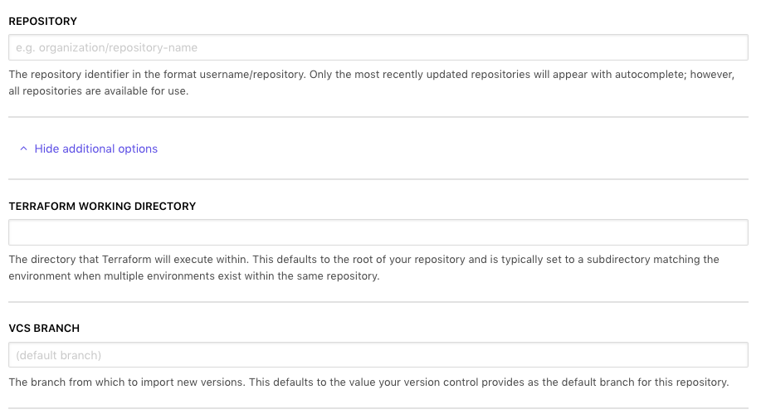
Workspace – VC Connection
https://www.terraform.io/docs/enterprise/vcs
Notes:
Version Control Connection – github, gitlab, bitbucket
Options:
- working directory
- branch

Slide 168
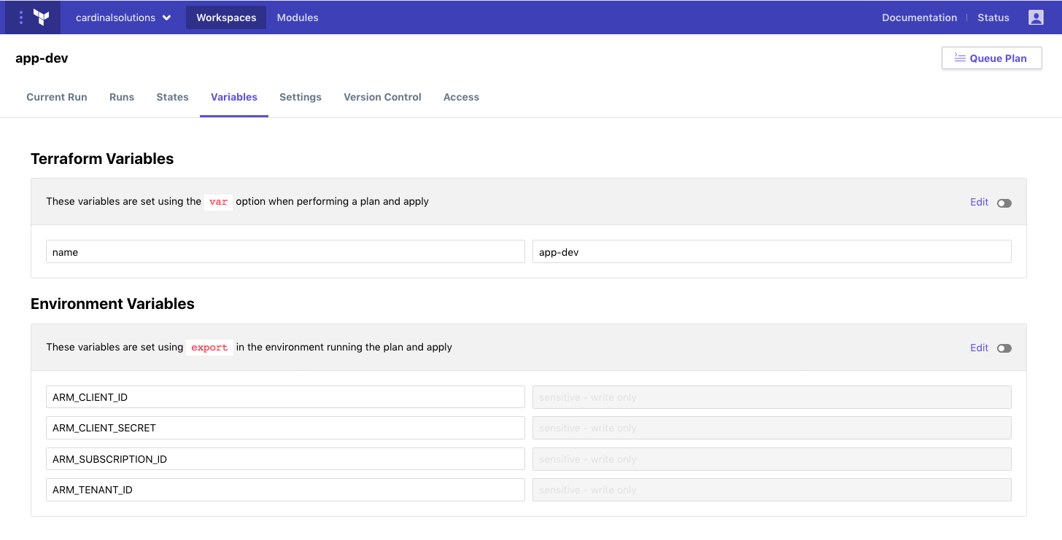
Workspace – Variables
https://www.terraform.io/docs/enterprise/workspaces/variables.html

Slide 169


Workspace – Variables
https://www.terraform.io/docs/enterprise/workspaces/variables.html
Notes:
HCL Type Variable
Sensitive
Nobody (including you) can view the value in TFE's UI or API. COULD BE IN LOGS
Nobody can edit the variable's name or value
Also works on ENV Vars

Slide 170
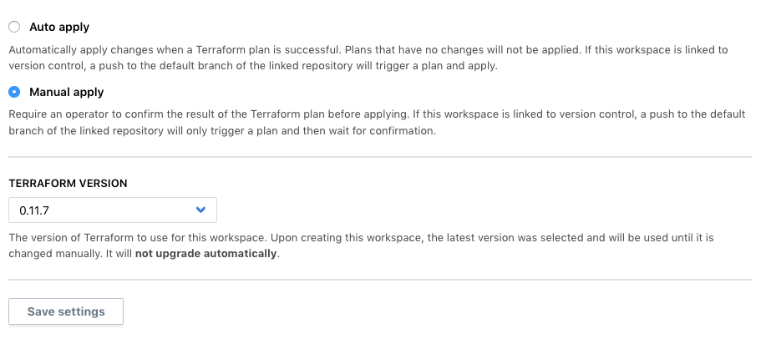
Workspace – Settings
https://www.terraform.io/docs/enterprise/workspaces/variables.html

Slide 171
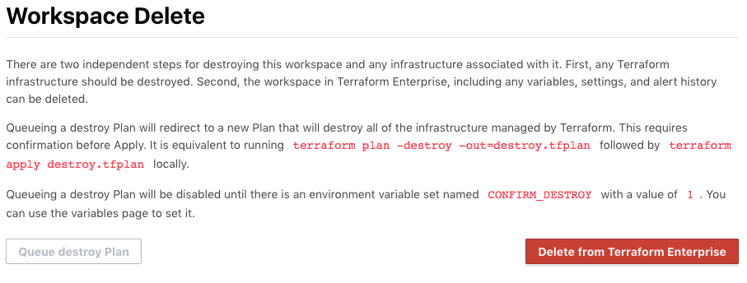
Workspace – Settings
https://www.terraform.io/docs/enterprise/workspaces/variables.html
Notes:
Deleting Works space infra
Update ENV Var
Click Destroy Plan

Slide 172
Remote State

Slide 173
Remote Terraform runs and state management
INFRASTRUCTURE AS CODE
PROVISIONING WORKFLOW
DEVELOPERS
Plan
OPERATORS
Core
Provider
Apply
Notes:
Terraform runs including the plan and apply can be done remotely.
Terraform Enterprise provides enhanced remote state storage
Runs triggered from the CLI also show up in the UI. Users can continue using the same OSS workflow (if that is what they are comfortable with) and it registers with TFE.

Slide 174
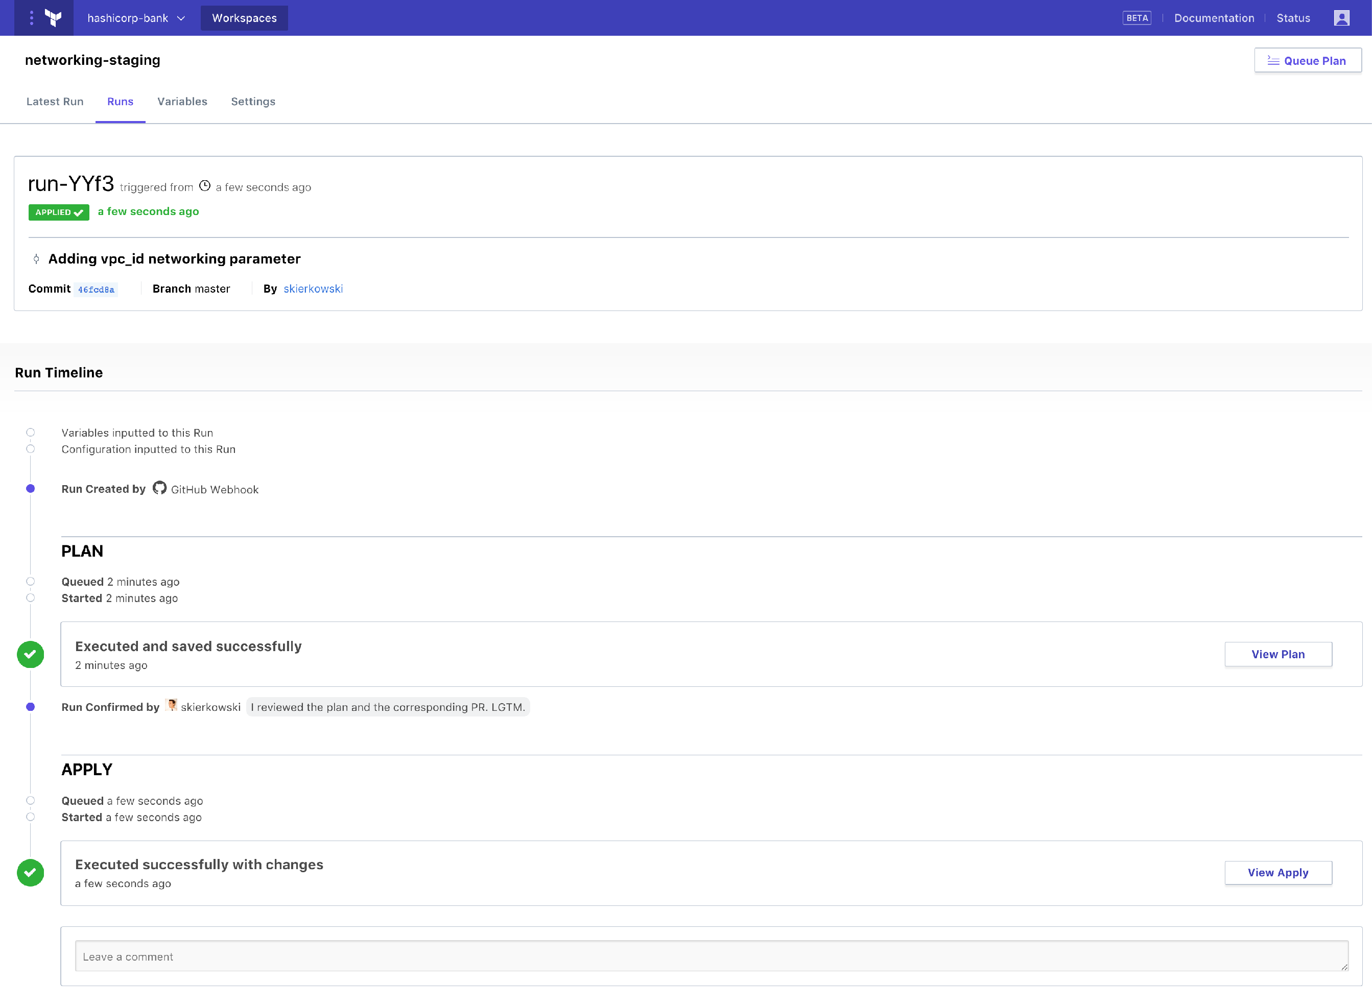
Remote state management and Terraform runs
INFRASTRUCTURE AS CODE
TEAMS OF DEVELOPERS
TFE Workspace Management
TEAM OF OPERATORS
Core
Provider
VCS
Terraform Configuration
Notes:
Here is a view of a Terraform run from Terraform Enterprise.
Terraform Infrastructure as code and Terraform Enterprise Workspace management and collaboration enables operators to automate provisioning at scale. However, this comes with risks, as every action can have larger effect.

Slide 175
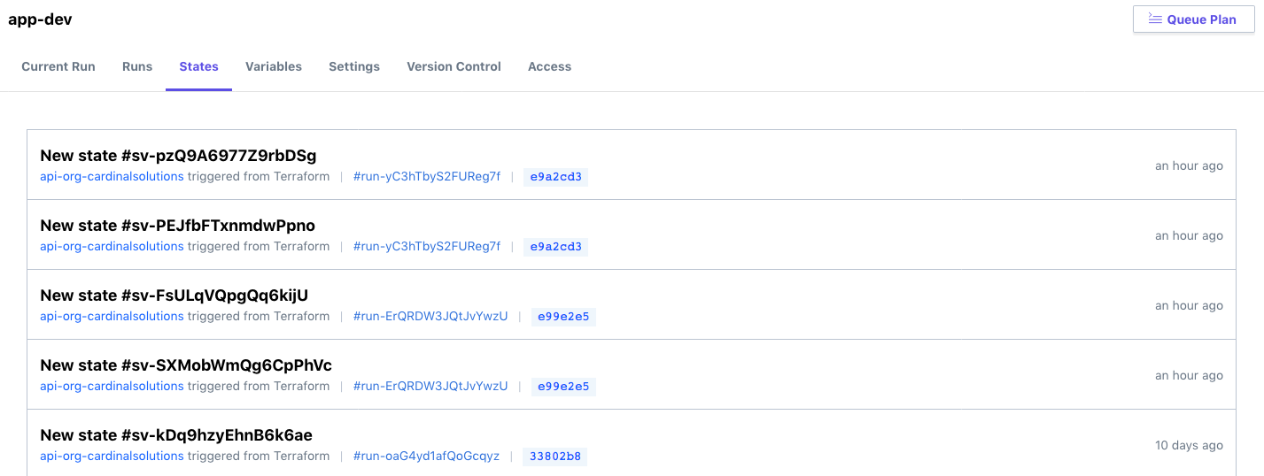
Workspace – State Management

Slide 176
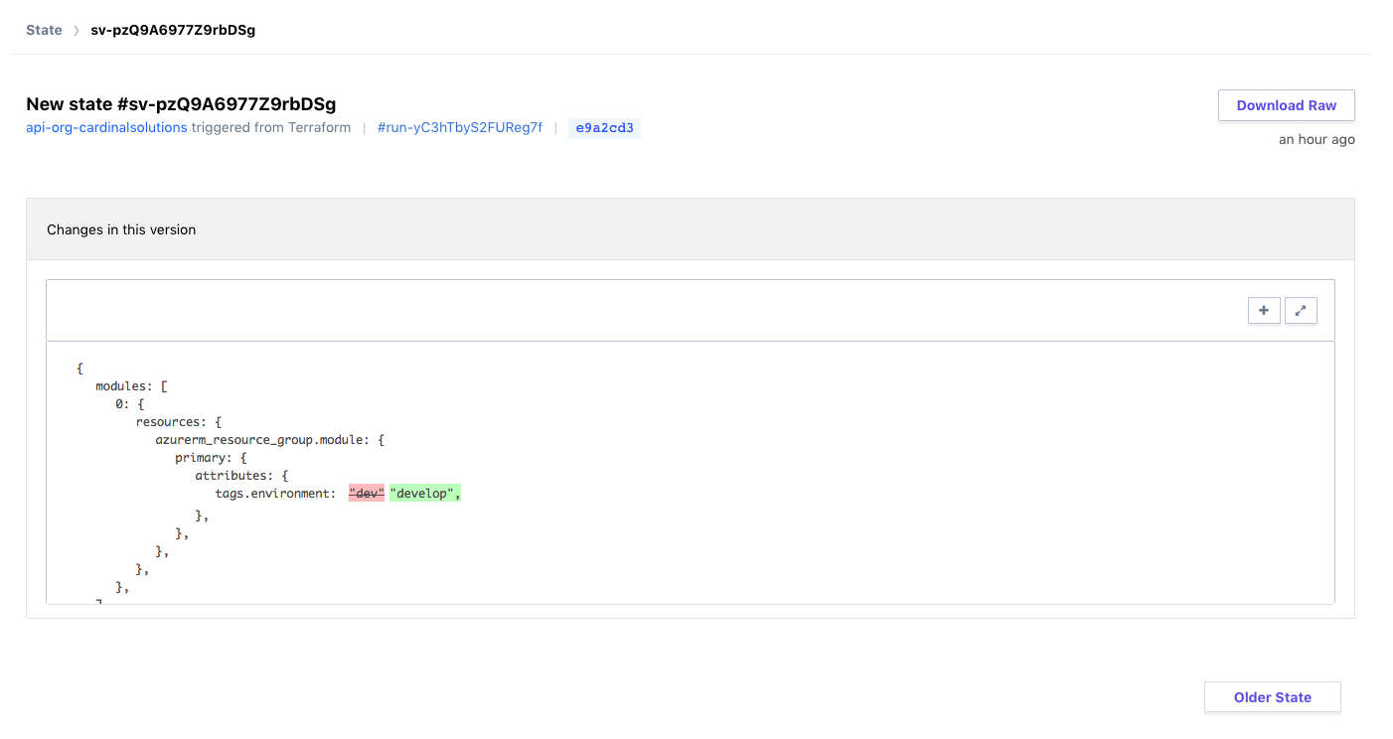
Workspace – State Management

Slide 177
Challenge
08 - Terraform Enterprise Setup

Slide 178
Collaboration

Slide 179
Collaboration
Role Based Access Controls
Permissions
Read
Write
Admin
Notes:
Devs can apply to dev environment, but not to Prod
Typical RBAC methodology

Slide 180
Collaboration
Role Based Access Controls
Organization
Teams
Users
Notes:
Devs can apply to dev environment, but not to Prod
Typical RBAC methodology

Slide 181
Service Accounts
API Tokens
User
Team
Organization
Notes:
Just as a user/team/org can be scoped, so can the API Tokens
Inherit the same permissions

Slide 182
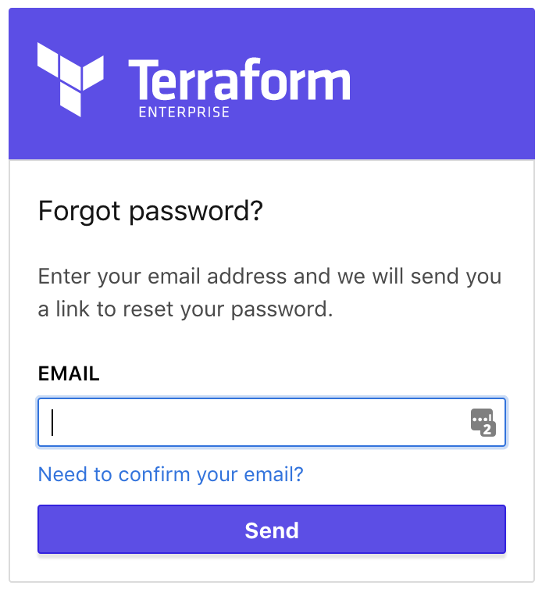
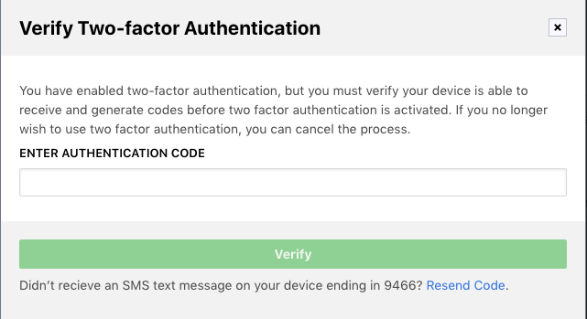
User Authentication
Notes:
Self Service Password Reset
2FA

Slide 183
Demo
Notes:
Create feature branch against workspace app-dev to update a tag.
Submit PR – see TFE running plans
These plans are temp and not linkable from TFE directly, use github.
Accept PR and see official plan.
Review and apply.

Slide 184
Private Module Registry

Slide 185
Private Module Registry
Modules for sharing across organization
Versioning
Notes:
Used in the same way as the Public Module Registry.
Allows sharing/collaboration

Slide 186
Private Module Registry
Show Module discovery in private repo
Documentation of modules
Notes:
Used in the same way as the Public Module Registry.
Allows sharing/collaboration

Slide 187
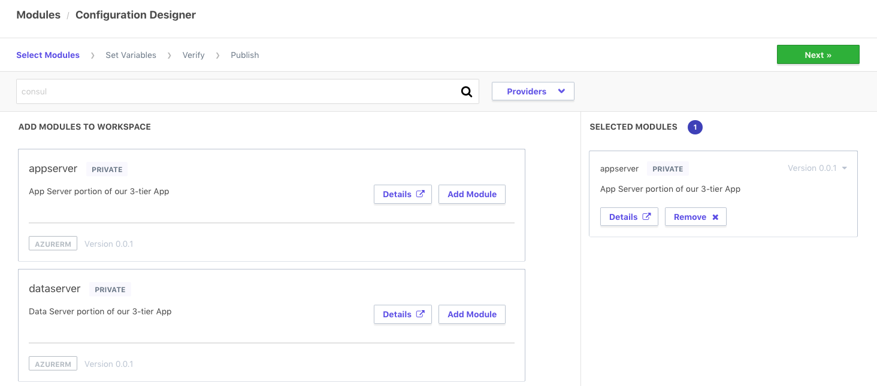
Design Configuration

Slide 188
Demo
Notes:
Create a new module design configuration.
Use an existing module and populate values.

Slide 189
Challenge
09 - Private Module Registry

Slide 190
Governance

Slide 191

Enable Organization to have governance over infrastructure
Ensure provisioning policy is being maintained to minimize risk to the business
INFRASTRUCTURE AS CODE
PROVISIONING WORKFLOW
Extensible provider model
DEVELOPERS
Plan
GCP
√
OPERATORS
Core
Provider
√
AWS
√
Azure
√
Apply
Notes:
Then the execution phase happens and the resources are provisioned across the various providers detailed in the configuration file.
However, the as more resource are provisioned by more users the challenges is in making sure infrastructure changes are doing so within business and/or regulatory policy. Such policies might be:
Not allow resources to be provisioned without tags
Not allow “development” resources to be provisioned in “us-east-1”
Restrict AWS security group ingress and egress settings by CIDR block
Not allow resources to be provisioned outside of business hours
Manually trying to enforce these constraints will be difficult once usage scales beyond a few people provisioning infrastructure.
And to address this is policy as code to automate policy checks.

Slide 192
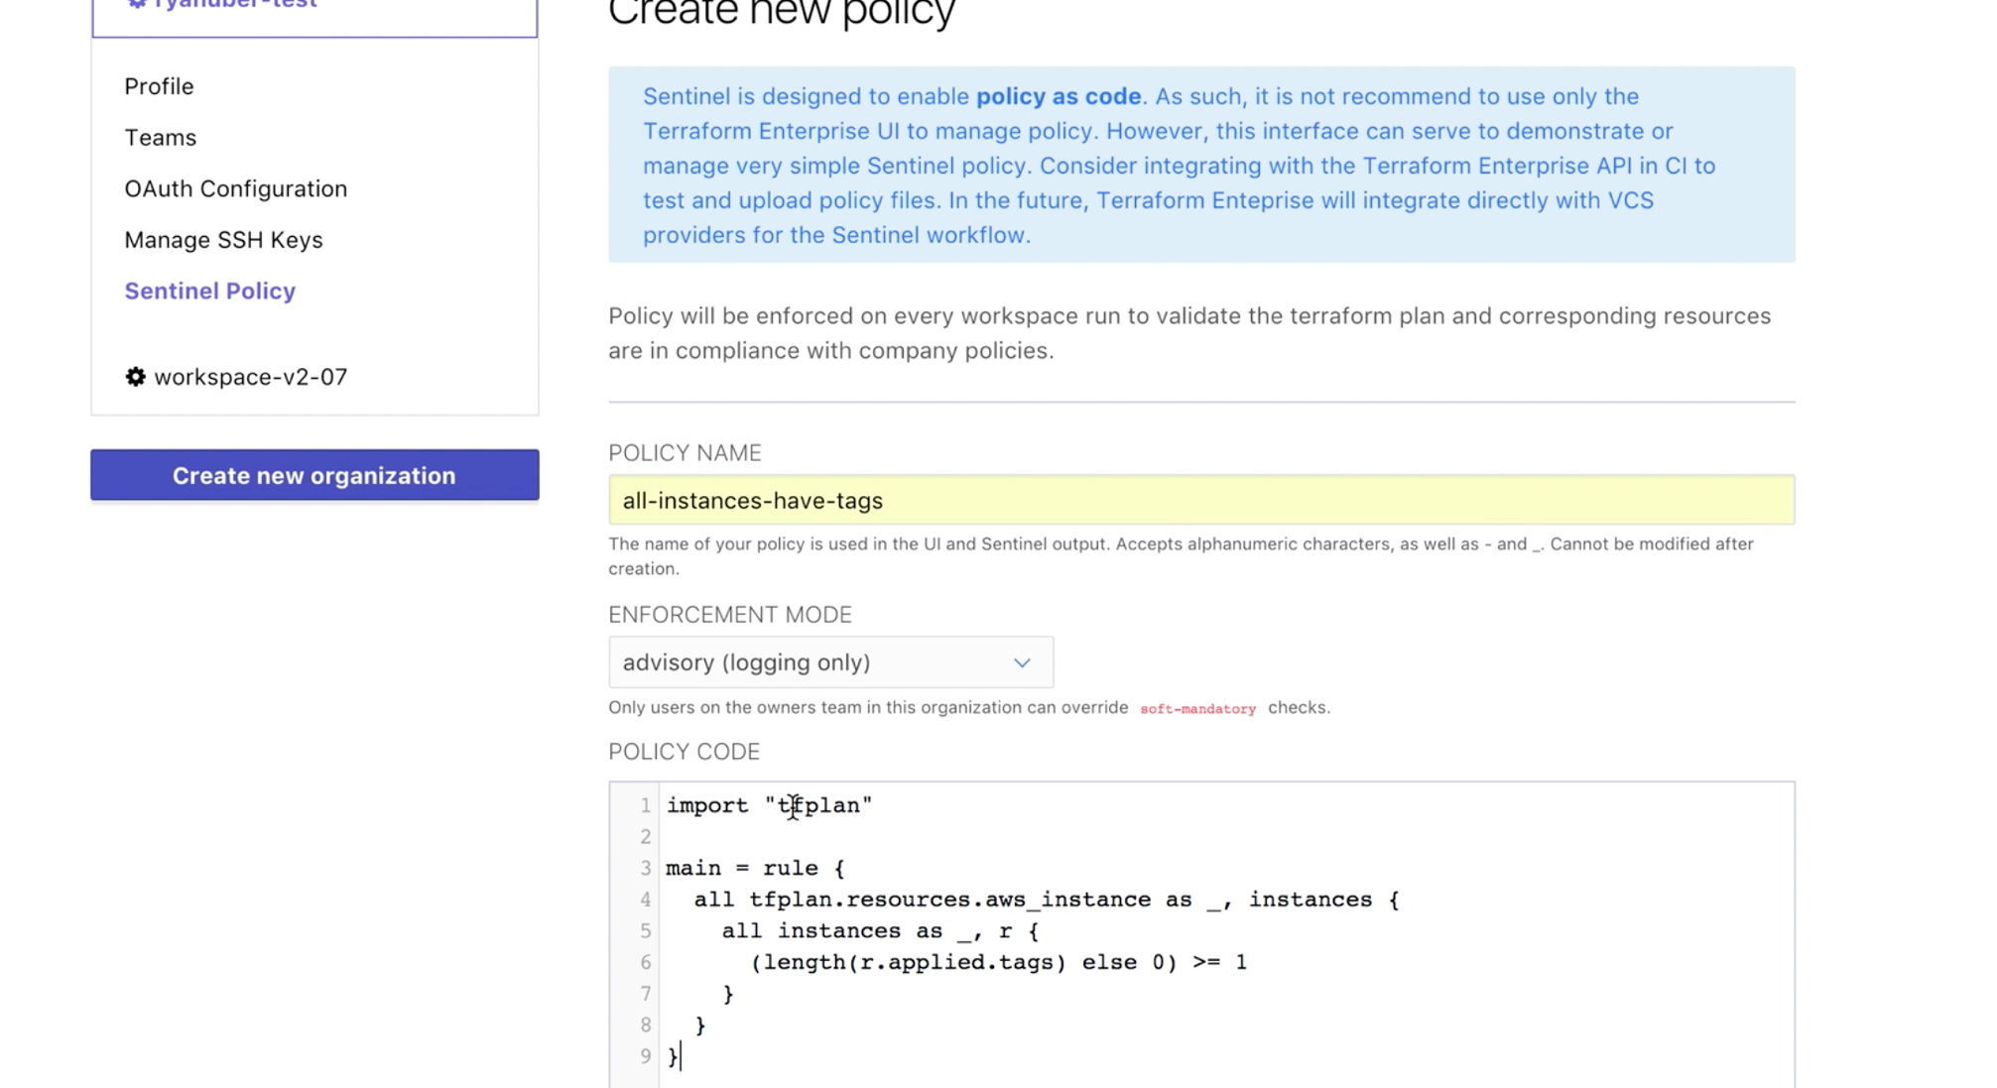
Enable Organization to have governance over infrastructure
Automate policy with Sentinel policy as code management
INFRASTRUCTURE AS CODE
DEVELOPERS
OPERATORS
Core
Provider
VCS
+ policy
Notes:
HashiCorp Sentinel is a policy as code framework and allows these types of constraints to be codified and automated with in Terraform Enterprise.
Sentinel policies are configured on an organization within Terraform Enterprise and are applied to all runs on all workspaces within that organization.
Policy code is entered into Terraform Enterprise using the API or the web UI, and full VCS integration for policy as code will be coming soon.

Slide 193

Enable Organization to have governance over infrastructure
Ensure provisioning policy is being maintained to minimize risk to the business
DEVELOPERS
Plan
OPERATORS
Core
Provider
Apply
Notes:
Example policy for infrastructure provisioning:
Do not allow resources to be provisioned without tags
Only allow staging resources in us-west-1 and production resources in us-east-1
Do not allow AWS security groups to have egress set to 0.0.0.0

Slide 194
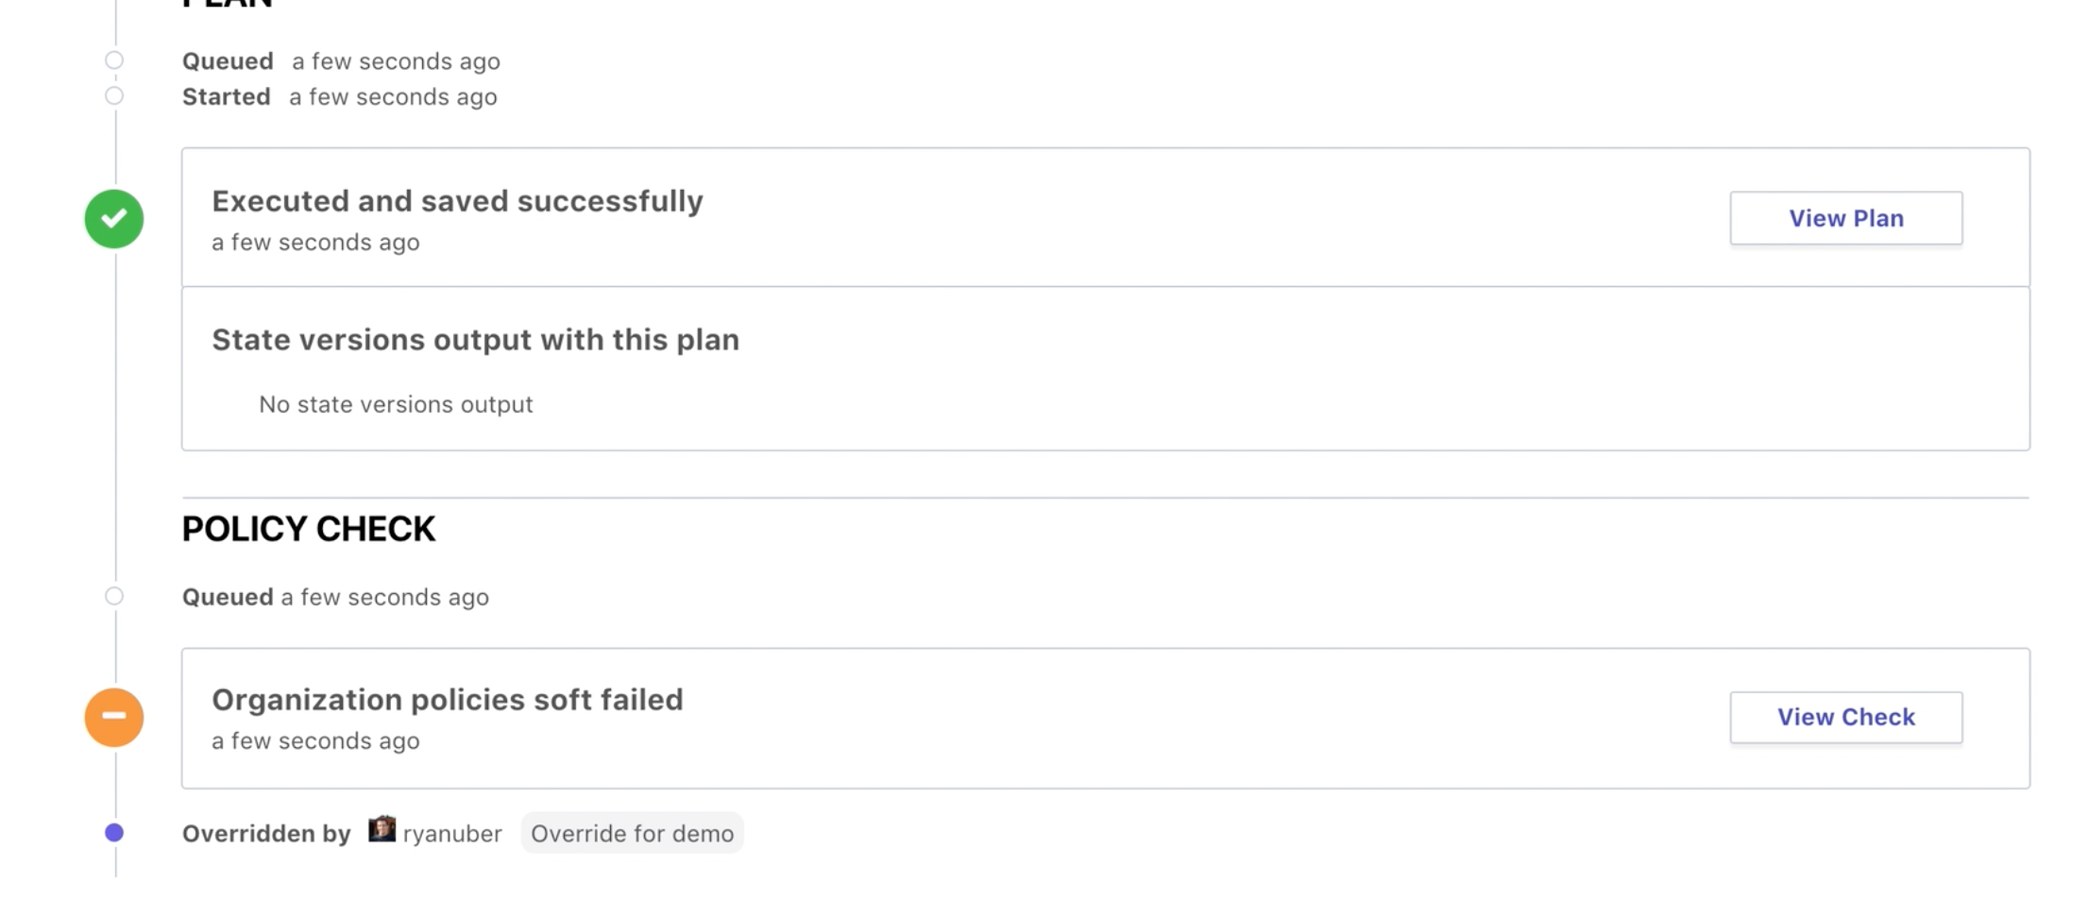
Enable Organization to have governance over infrastructure
Automate policy to be enforced on every Terraform run
INFRASTRUCTURE AS CODE
PROVISIONING WORKFLOW
DEVELOPERS
Plan
OPERATORS
Core
Provider
√
Apply
Notes:
The policy check is built into the Terraform workflow after the Terraform plan.
The “tfplan” plugin is imported, and then used to access the set of Terraform resources we are interested in, for the policy to actually be checking.
Sentinel policies in Terraform Enterprise are enforced immediately after a plan completes. This is reflected on the Runs view page. The “Policy Check” section will appear when the plan completes
For policy checks, there are various enforcement levels to provide the appropriate level of constraint while still enabling productivity. There are 3 levels to choose from:
Advisory mode logs warnings, but does not prevent runs from being applied. This is useful for teaching users good habits without preventing actions.
Soft mandatory mode requires an operator with appropriate permissions to override any policy failures prior to an apply. This is useful for policies like "Users cannot provision outside of business hours", which require a failsafe.
Hard mandatory mode does not allow any override, and policies must pass prior to an apply. This is useful for policies that enforce regulatory requirements like "All database volumes must be encrypted."
The workspace owner is able to confirm and apply a run that passes policy checks freely.

Slide 195
Enable Organization to have governance over infrastructure
Ensure provisioning policy is being maintained to minimize risk to the business
DEVELOPERS
Plan
OPERATORS
Core
Provider
Apply
Notes:
Here is a view of a Terraform run from Terraform Enterprise with the policy check applied after the Terraform plan.
This particular run had a soft fail that was able to be overridden by a user with the appropriate permission.

Slide 196
Enable Organization to have governance over infrastructure
Automate policy to be enforced on every Terraform run
INFRASTRUCTURE AS CODE
PROVISIONING WORKFLOW
Extensible provider model
DEVELOPERS
Plan
GCP
√
OPERATORS
Core
Provider
√
√
AWS
Azure
√
Apply
Notes:
With Sentinel policy as code the appropriate guardrails are automatically in-place to protect users from creating infrastructure changes that fall outside of business and/or regulatory policies.

Slide 197
Challenge
10 - Sentinel Policy

Slide 198
Questions?

Slide 199
1 Week PoC
C
Pre-Requisites
- An available Azure subscription with sufficient funding
- Desired set of infrastructure to deploy to Azure
- Availability of required SMEs (application architects,
cloud architects, DevOps manager, etc.)
What You Will Get
- Purpose built infrastructure configuration based on your organizations needs/goals utilizing the best practices established performing large scale deployments
- Terraform configuration representing a one or more application environments including necessary networking (Vnets/Subnets/Peerings)
- Remote state configuration allowing for multiple team collaboration
- Terraform Enterprise integration and design considerations
- Presentation and documentation to prepare your teams to develop, maintain, and deploy your Terraform

